Slide 1
Back in time
A WebQuest
6th Grade

Slide 2
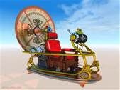
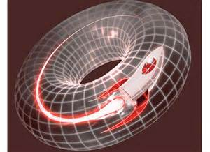
Student pages

Slide 3
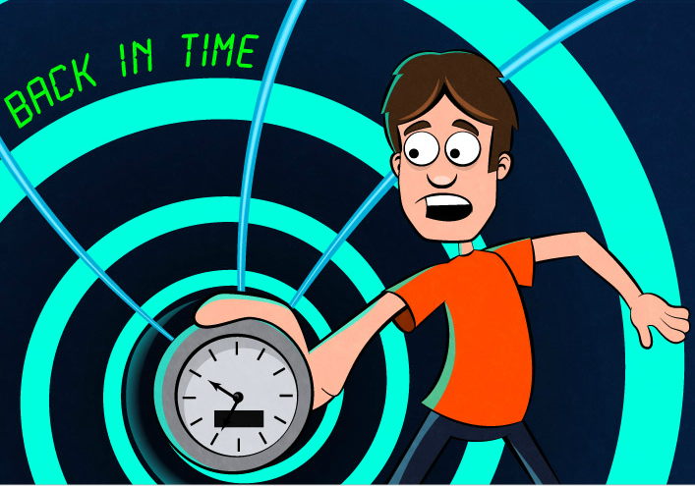

Slide 4
Introduction
Have you ever wanted to travel back in time?
What time period would you visit?
What kind of clothes would you have to wear?
What do you think the people were like during this time period?
Was there anything historical happening during this time period?
What kind of animals might you encounter?
What was the weather like?
Where would you stay?

Slide 5
Task
Task 1
Task 2
Task 3
Research! Research! Research! Research!
You will be able to select a specific time period and find out as much information as you can about it.
Graphic Organizer
You will develop a graphic organizer to help organize your research information about the time period you are visiting.
Journal
You will write in your journal about the time period you are researching and visiting.

Slide 6
Task
Task 4
Travel Brochure
You will design and create a travel brochure with the information from your research.
Task 5
Share! Share! Share! Share!
You will share your brochure with the class and state why they should visit that particular time period.

Slide 7
process
Step 1: Decide on what time period you want to visit and start your research.
Step 2: Once you decide on a time period, you may use the computer, books,
magazines, or newspaper articles to do your research.
Resources: www.loc.gov
www.nationalgeographic.com
www.history.com
www.hyperhistory.com
http://exhibits.museum.state.il.us/exhibits/athome/welcome.htm
http://www.pbs.org/wgbh/nova/pyramid/

Slide 8
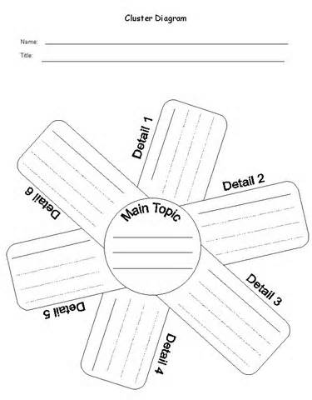
Process continued
Step 3: You will need to start taking notes on the information you want to use for your final project. You need to organize the notes with a graphic organizer. You can design your own or use one of the samples given.

Slide 9
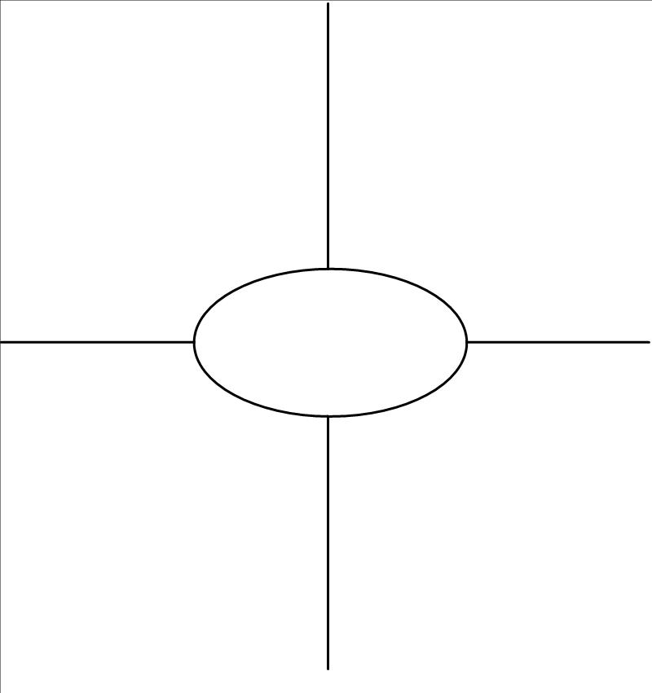
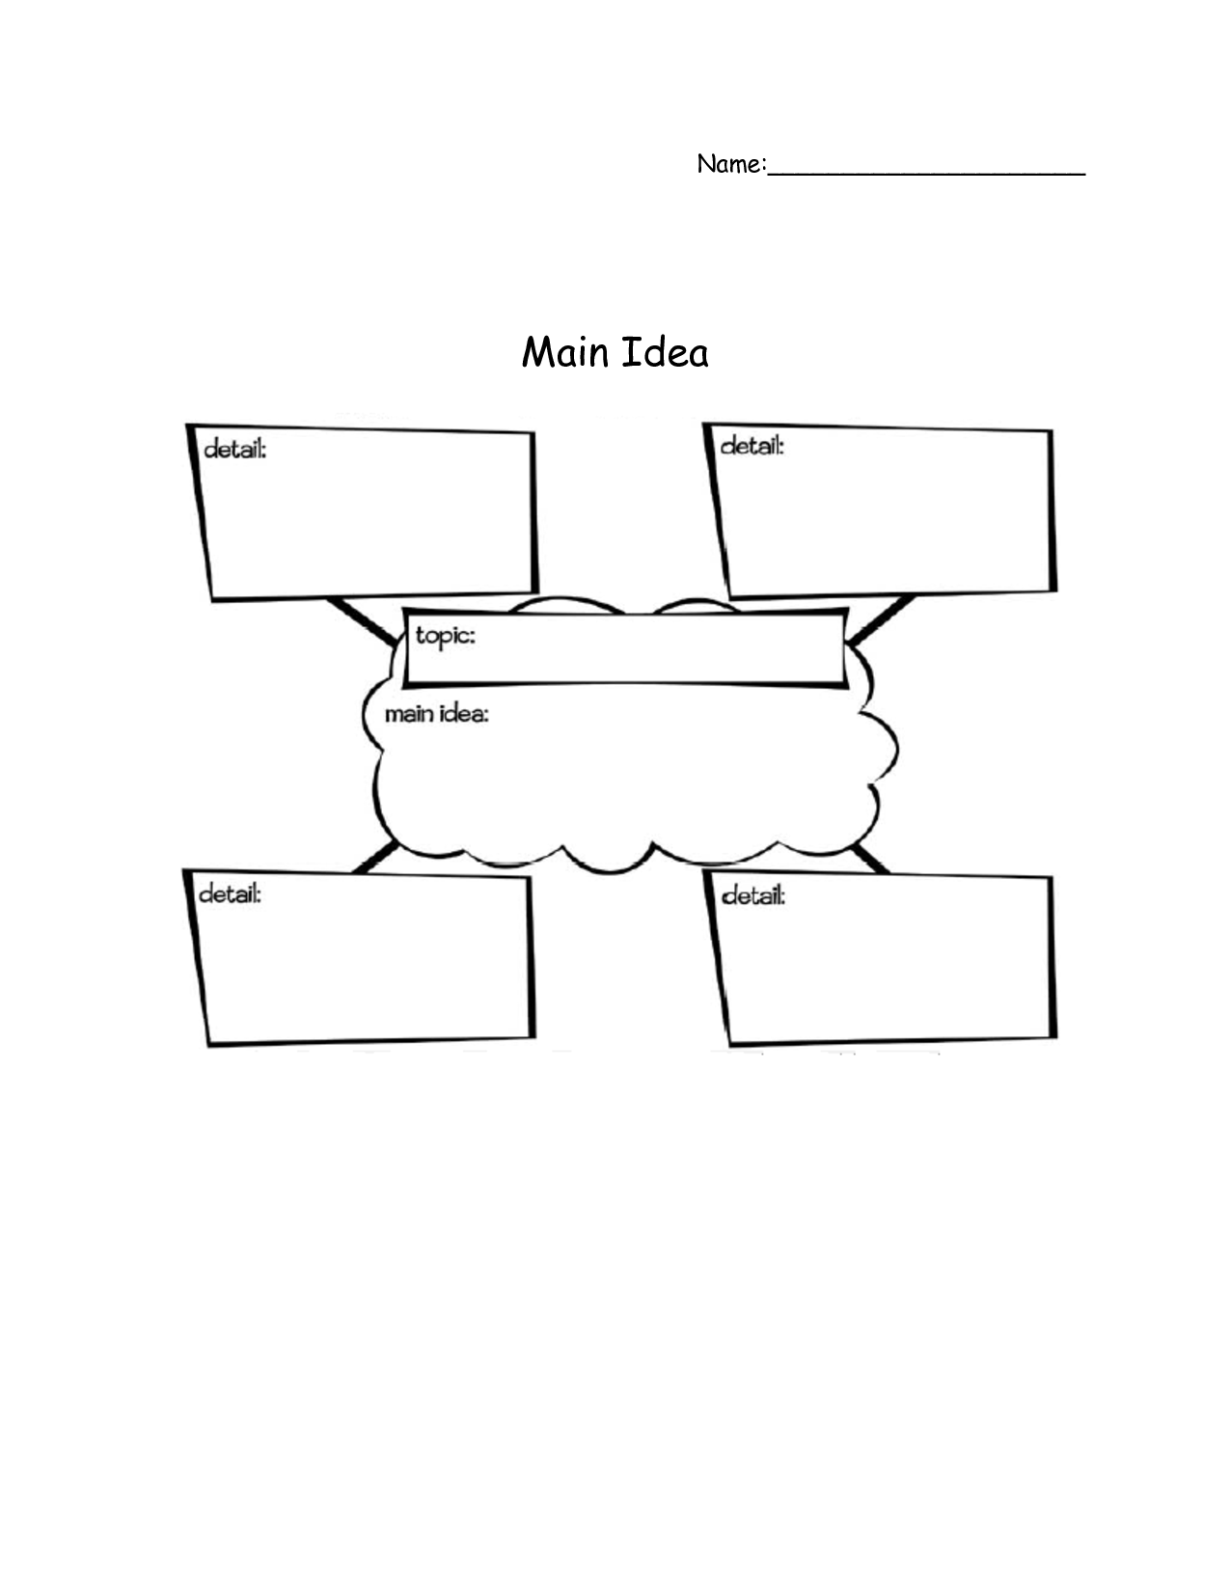
Process Continued
More examples of graphic organizers you can use to collect your research.

Slide 10
Process Continued
Step 4: You now will take the information in your graphic organizer and start writing in your journal. You need to describe the time period you selected and write details about it. What would it be like to live during this time? What kind of clothes were worn? What would the weather be like? What kind of animals would you see, etc.?
Step 5: You will design and create a travel brochure about the time period you are researching. You will include your research for other classmates to select as they use the time machine. They will know what to expect when they arrive. For example: How to dress, what the weather will be like, and what they might encounter on their journey. You can create a design online using the sample template or you can draw one yourself using art materials! Have fun!

Slide 11
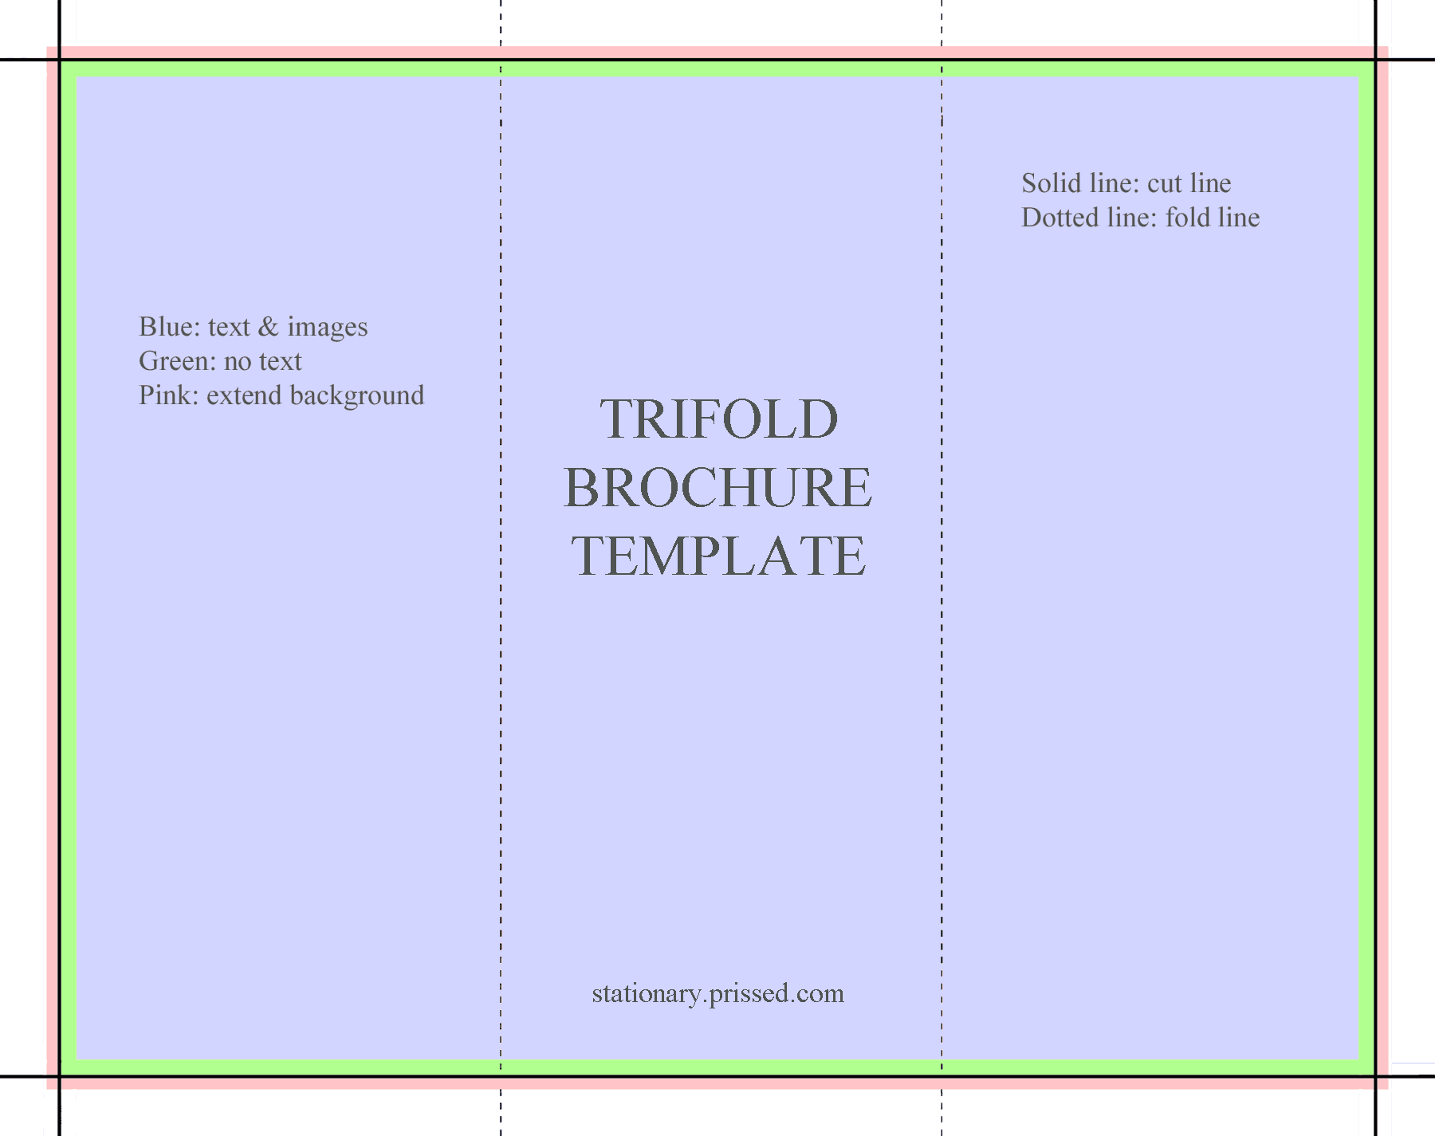
Process Continued
Here is a template for your brochure:

Slide 12
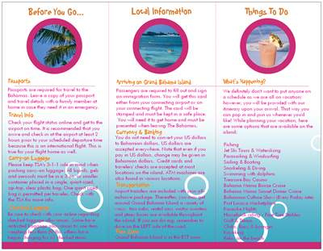
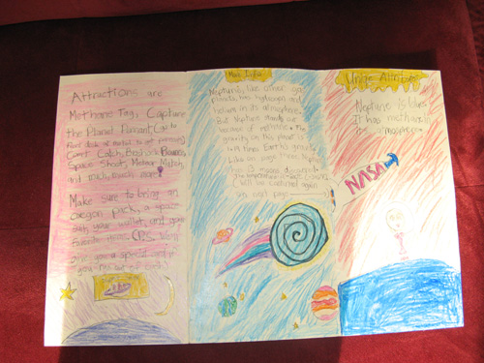
Process Continued
Step 6: Now you get to show off the brochure you have created! You will present to the classroom your brochure. You will discuss the time period, why you chose it, your brochure, and any other interesting facts you want to share!

Slide 13
Assessment Rubric
Category | 4 | 3 | 2 | 1
RESEARCH | Student used time wisely for researching and used proper research material | Student mainly used time wisely and used proper research material | Student sometimes used time wisely and mainly used proper research material | Student rarely used time wisely and sometimes or rarely used proper research material
GRAPHIC ORGANIZER | Student created an effective graphic organizer to organize the information they’ve researched | Student created a mostly effective graphic organizer to organize information they’ve researched. | Student created a graphic organizer that somewhat helps organize information they’ve researched. | Student did not create a graphic organizer that helps them organize information they’ve researched
BROCHURE | Brochure was well done, with use of pictures and text. Brochure was very helpful in learning about that time period | Brochure was almost well done with use of pictures and text. Brochure was mainly helpful in learning about that time period. | Brochure was somewhat well done. Some pictures and text were used. Brochure was somewhat helpful in learning about that time period. | Brochure was not well done and was not helpful in learning about that time period.
PRESENTATION | Was informative and covered the brochure and any other interesting facts learned | Was mostly informative and covered the brochure and some other interesting facts learned | Was sometimes informative and covered the brochure and a few interesting facts learned | Was rarely helpful, rarely covered the brochure, and did not list any interesting facts learned

Slide 14
conclusion
Congratulations! You have finished your travel brochure and your time travel to another time period. You have also learned about other time periods that you may want to travel to and explore!
“There is a garden in every childhood, an enchanted place where colors are
brighter, the air softer, and the morning more fragrant than ever again.”
Elizabeth Lawrence
*Just remember to have fun and keep exploring!

Slide 15
credits
This lesson was created by Johnica Haynes and Samantha Burch. A lot of time and effort was put into this, so please enjoy!

Slide 16
Teacher pages

Slide 17
introduction
The purpose of this webquest is for our students to think critically about the various periods of time they would have liked to travel to. By allowing the students the freedom to choose their time period for their research they will have more investment in the project making sure they are accurate in their information gathering. The students will also have a creative hand in making their own brochure.

Slide 18
learners
This assignment is aimed at six graders in the concentrations of Language Arts and Social Studies. The students will need the skills of productive researching, organizing, writing, and creating. Students will accomplish these tasks using graphic organizers, journaling, and creating a brochure. The students do not need to possess prior knowledge on their chosen time period due to the time allowed for research.

Slide 19
standards
CCSS.ELA-LITERACY.RH.6-8.7 Integrate visual information (e.g., in charts, graphs, photographs, videos, or maps) with other information in print and digital texts.
CCSS.ELA-LITERACY.RH.6-8.8 Distinguish among fact, opinion, and reasoned judgment in a text.
CCSS.ELA-LITERACY.WHST.6-8.2.A Introduce a topic clearly, previewing what is to follow; organize ideas, concepts, and information into broader categories as appropriate to achieving purpose; include formatting (e.g., headings), graphics (e.g., charts, tables), and multimedia when useful to aiding comprehension.
CCSS.ELA-LITERACY.WHST.6-8.4 Produce clear and coherent writing in which the development, organization, and style are appropriate to task, purpose, and audience.
CCSS.ELA-LITERACY.WHST.6-8.8 Gather relevant information from multiple print and digital sources, using search terms effectively; assess the credibility and accuracy of each source; and quote or paraphrase the data and conclusions of others while avoiding plagiarism and following a standard format for citation.

Slide 20
Process
Step 1:Get all handouts from the teacher(graphic organizer and journaling paper)
Step 2:Choose a time period to research and begin researching.
Step 3:Use the graphic organizer to organize your thoughts and research notes.
Step 4:While working on research journal about your selected time period and what research you have found.
Step 5:After all research is done organize your information into what you want your journal to look like.

Slide 21
Process continued
Step 6:Once you have organized your pictures, and information get the brochure materials from the teacher.
Step 7:Create your brochure, make sure to eliminate all errors prior to creating so your brochure will look professional.
Step 8:Once you have completed your brochure turn it into the teacher.
Step 9:Once everyone is complete you will share your brochure and the information you collected to the class.

Slide 22
Credits
Created by Johnica Haynes and Samantha Burch for ETE 315. We hope that by using this webquest your students will successfully research their favorite time period and bring life to the history of the world.

Slide 23
Rubric
Category | 4 | 3 | 2 | 1
RESEARCH | Student used time wisely for researching and used proper research material | Student mainly used time wisely and used proper research material | Student sometimes used time wisely and mainly used proper research material | Student rarely used time wisely and sometimes or rarely used proper research material
GRAPHIC ORGANIZER | Student created an effective graphic organizer to organize the information they’ve researched | Student created a mostly effective graphic organizer to organize information they’ve researched. | Student created a graphic organizer that somewhat helps organize information they’ve researched. | Student did not create a graphic organizer that helps them organize information they’ve researched
BROCHURE | Brochure was well done, with use of pictures and text. Brochure was very helpful in learning about that time period | Brochure was almost well done with use of pictures and text. Brochure was mainly helpful in learning about that time period. | Brochure was somewhat well done. Some pictures and text were used. Brochure was somewhat helpful in learning about that time period. | Brochure was not well done and was not helpful in learning about that time period.
PRESENTATION | Was informative and covered the brochure and any other interesting facts learned | Was mostly informative and covered the brochure and some other interesting facts learned | Was sometimes informative and covered the brochure and a few interesting facts learned | Was rarely helpful, rarely covered the brochure, and did not list any interesting facts learned

Slide 24
conclusion
Congratulations you have successfully completed the back in time webquest! We hope that by doing this webquest you have learned some new information about the various times in history.

Slide 25
resources
Antonacci, P. & O’Callaghan, C. (2006). A handbook for literacy instructional & assessment strategies K-8. Boston, MA: Pearson, Allyn, and Bacon.
http://www.escapegames24.com/2013/10/back-in-time.html
http://exhibits.museum.state.il.us/exhibits/athome/welcome.htm
http://www.pbs.org/wgbh/nova/pyramid/
www.history.com
www.hyperhistory.com
library.thinkquest.org
www.loc.gov
www.nationalgeographic.com
stationary.prissed.com

