Slide 1
Museum Entrance
The War of Rebellion:
An Exploration of the U.S. Civil War
Curator Room Curators: Katie Carson, Katelyn Waller, Janessa George
The North
The South
African American Involvement
Famous Battles
Emancipation
Proclamation

Slide 2
Curator Information
Civil War
This exhibition explores the perennially fascinating subject of the American Civil War. The battle between the Northern states and the Southern states lasting from 1861–1865 is one of the biggest conflicts in U.S. history. Utilizing various Common Core and NCSS standards students will explore this time under the categories of: the North, the South, African American Involvement and Famous battles. Students will become more knowledgeable of the war and all that it entailed.
Standards
Standards
Resources
Back to Lobby
Standards
Resources
Note: Virtual museums were first introduced by educators at Keith Valley Middle School in Horsham, Pennsylvania. This template was designed by Lindsey Warneka under the direction of Dr. Christy Keeler during a Teaching American History grant module. View the Educational Virtual Museums website for more information on this instructional technique.

Slide 3
The North
Civil War
Back to Lobby

Slide 4
The South
Civil War
Back to Lobby
Notes:
4

Slide 5
African American Involvement
Civil War
Back to Lobby
Notes:
5

Slide 6
Famous Battles
Civil War
Back to Lobby
Notes:
6

Slide 7
Emancipation Proclamation
The Emancipation Proclamation was issued by President Abraham Lincoln on January 1, 1863. The proclamation was life altering for African Americans as it declared "that all persons held as slaves" within the rebellious states "are, and henceforward shall be free.“
One downside of this proclamation was its limitations. It applied only to states that had seceded from the Union, leaving slavery untouched in the loyal border states. Most important, the freedom it promised depended upon Union military victory.
Although the Emancipation Proclamation did not end slavery in the nation, it announced the acceptance of black men into the Union Army and Navy. By the end of the war, almost 200,000 black soldiers and sailors had fought for the Union and freedom.
This document is a milestone along the road to the destruction of slavery. It has earned a place among the great documents of human freedom.
Back to Room 1

Slide 8
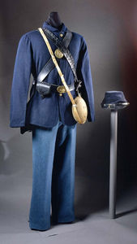
Union Infantry Uniforms
Physical Description
Dark blue wool fatigue jacket with a roll down collar, four buttons. Light blue Kersey cloth trousers. Dark blue wool forage cap. Shoulder belt with cartridge box and waist belt with percussion cap box and bayonet. Canteen.
General History
At the start of the Civil War enlisted men in the U.S. Army were issued two coats. One was a frock coat which had a standing collar, reached almost to the knees and was closed in the front with nine brass eagle buttons. The frock coat was a dress coat and was piped with the branch-of-service color around the cuffs and collar. The other coat was the fatigue coat. This coat was worn when performing regular duties. According to the 1861 regulations the trousers were to be dark blue just as the coats. This was changed to sky blue on 16 December 1861 and lasted to the end of the war. As with the coats, two hats were issued, a formal black dress hat and the other was the forage cap.
Back to Room 1

Slide 9
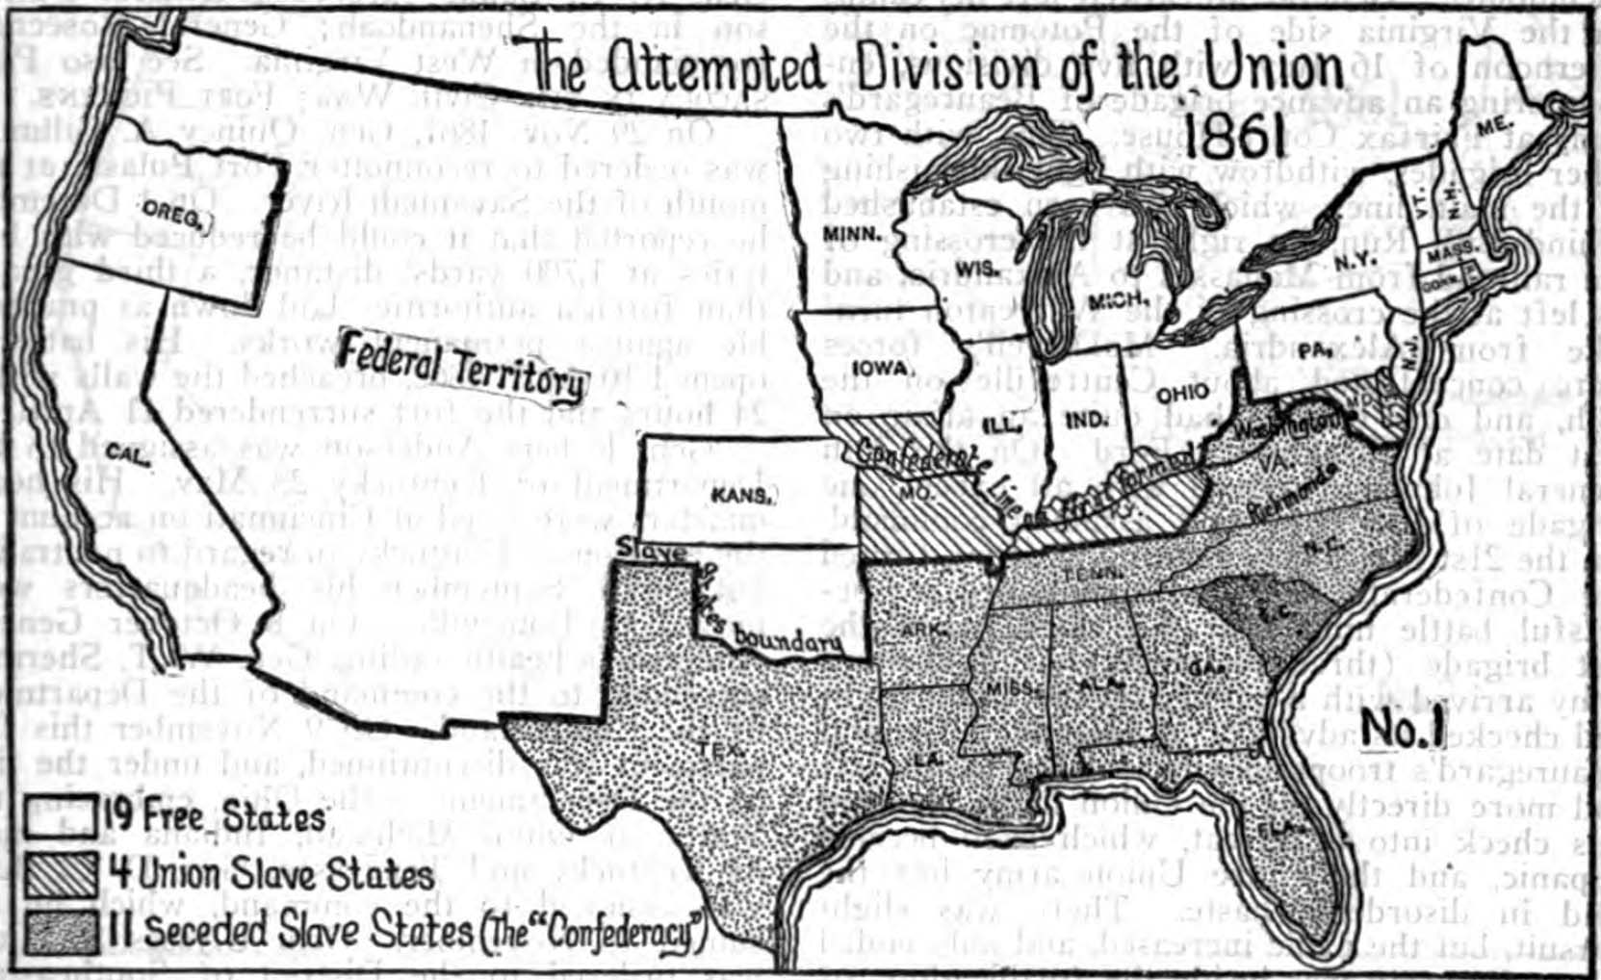
Map of the Union
The North included Connecticut, Illinois, Indiana, Iowa, Kansas, Maine, Massachusetts, Michigan, Minnesota, Missouri, Nebraska, New Hampshire, New Jersey, New York, North Dakota, Ohio, Pennsylvania, Rhode Island, South Dakota, Vermont, and Wisconsin.
The Confederate states seceded
South Carolina - December 20, 1860
Mississippi - January 9, 1861
Florida - January 10, 1861
Alabama - January 11, 1861
Georgia - January 19, 1861
Louisiana - January 26, 1861
Texas - February 1, 1861
Virginia - April 17, 1861
Arkansas - May 6, 1861
North Carolina - May 20, 1861
Tennessee - June 8, 1861
Back to Room 1

Slide 10
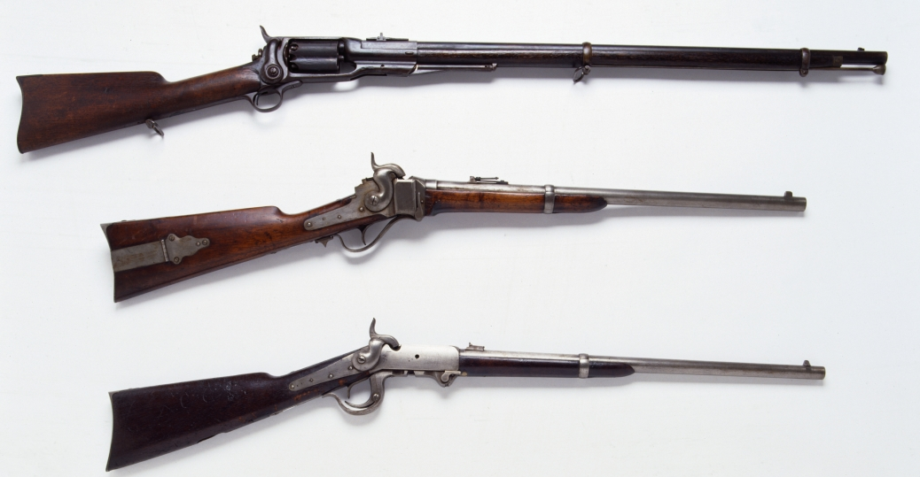
Manufactured Products
By 1860, 90 percent of the nation's manufacturing output came from northern states.
In 1860, the North manufactured 97 percent of the country's firearms, 96 percent of its railroad locomotives, 94 percent of its cloth, 93 percent of its pig iron, and over 90 percent of its boots and shoes. The North had twice the density of railroads per square mile.
The North produced 17 times more cotton and woolen textiles than the South, 30 times more leather goods, 20 times more pig iron, and 32 times more firearms. The North produced 3,200 firearms to every 100 produced in the South.
Back to Room 1

Slide 11
Stonewall Jackson
This is a photo of famous Confederate general “Stonewall” Jackson. Thomas J. Jackson was born on January 21, 1824, and died on May 10, 1863. He is the most well known Civil War general after Robert E. Lee. Jackson is said to be one of the best tactical commanders in United States history. Jackson earned his nickname “Stonewall” during the first battle of Bull Run. It is said that during battle Southern general Barnard Bee shouted: “"There is Jackson standing like a stone wall. Let us determine to die here, and we will conquer. Rally behind the Virginians!", and thus the name “Stonewall” stuck.
Back to Room 2

Slide 12
Confederate Money
The first issue of paper money released by the Confederate States of America took place in April, 1861. Unlike today’s money they were Demand Notes meaning they were non-interest bearing.
The Confederacy never issued coins due to the scarcity of metal. As a compromise 70 different paper notes were issued between 1861-1865. The total amount of currency issued in this time totaled $1.7 billion.
Confederate notes are designed with pictures of mythological Greek gods and goddesses. Images of slaves, ships, railroad trains, animals, state capitols were also used.
At first after the Civil War, Confederate currency was accepted for exchange and had high purchasing power. Soon after, Confederate currency became valueless. Some notes were destroyed as waste paper, some were hoarded out of sentiment or futile hope, and some were preserved as curios.
Back to Room 2

Slide 13
Confederate Uniform
The typical uniform of the Confederate soldier was a forage or slouch hat, gray or butternut wool shell jacket, gray, butternut, or blue trousers, and brogans.
- Forage caps differed in:
Color
Material
Marking dependent on rank
- Brogan: a heavy, ankle-high shoe or boot
A haversack was used to carry personal items. Confederate soldiers usually traveled lighter than their Union counterparts; instead of a knapsack, they typically carried their bedding rolled in their blanket and slung across one shoulder.
Back to Room 2

Slide 14
Underground Railroad
The Underground Railroad was a vast network of people who helped fugitive slaves escape to the North and to Canada. It was not an actual railway or run by an organization. It consisted of many individuals, some whites but predominantly black. Those involved were only aware of the local efforts to aid fugitives and not of the overall operation. This effectively moved hundreds of slaves northward each year.
The system used terms from railroading: the homes where fugitives would rest/eat were called "stations" and "depots" and were run by "stationmasters." Those who contributed money/goods were "stockholders," and the "conductor" was who moved fugitives from one station to the next.
For a runaway it was not easy. The first figuring how to escape from the slaveholder. The fugitives would move at night traveling between 10-20 miles. They would rest and eat, while they waited, for messages to be sent to the next station.
The Underground Railroad hard many notable participants, including John Fairfield in Ohio, the son of a slaveholding family, who made many daring rescues, Levi Coffin, a Quaker who assisted more than 3,000 slaves, and Harriet Tubman, who made 19 trips into the South and escorted over 300 slaves to freedom.
Back to Room 3

Slide 15
Recruitment Poster
When the American Civil War began in April 1861,young men volunteered by the thousands to make sure that they did not miss out on the war.
The turnout was so much greater than expected that the major problem facing the War was not the enlistment, but rather procurement of food, clothing, and armaments to sustain them. It was not until 1863 that African Americans were permitted to join the military.
Propaganda like that pictured encouraged their enlistment and as the war progressed, one in 10 soldiers was African American. They tended to serve in artillery and infantry. There were nearly 80 black commissioned officers. By the end of the Civil War, roughly 179,000 had served. Nearly 40,000 African American soldiers died,30,000 of those being from infection or disease.
As they suffered prejudice against them, black units were not used in combat as much. Regardless, the soldiers served with distinction, and by war's end, 16 black soldiers had been awarded the Medal of Honor for their valor.
Back to Room 3

Slide 16
Sgt. William H. Carney
William Carney was born a slave on February 29, 1840. His father, escaped slavery through the underground railroad. William Carney learned to read and write at the age of 15. William Carney gave up on being a minister and instead decided to join the army. This career had a great impact on his life.
At the age of 23 William joined the Morgan Guards which became part of the 54th Massachusetts regiment. The battle William is known for is the Battle of Fort Wagner. During this battle William Carney had risked his life. When the colored sergeant who was holding the flag was shot down, William Carney went to grab a hold of it. As he was heading to the parapet to plant the flag, he was shot in the leg, chest, his right arm. Although he was in so much pain he persevered. He would not let the flag fall to the enemy. Another bullet grazed his head. He finally reached safety and as he collapsed he said, "Boys, The Old Flag never touched the ground!"
William was discharged from the army on June 30, 1864, because of lingering effects of his wounds. He was awarded the medal of honor on May 23 1900. He was the first black soldier to receive this award. When he was asked about his heroic actions, all William said was "I only did My duty."
Back to Room 3

Slide 17
Battle of Gettysburg
This artifact is a map of the battlefield at Gettysburg. This battle was fought between July 1st and 3rd , 1863. The battle of Gettysburg was the South’s last full-scale attack on the Union troops. It was an important battle because it really helped to boost the morale of the Union troops. The South’s General Lee also led the infamous Pickett’s Charge during this battle. However, the charge failed and led to over 51,000 soldiers being killed, wounded, captured, or missing. This battle also led to Abraham Lincoln’s infamous Gettysburg Address.
Back to Room 4

Slide 18
Battle of Bull Run
http://www.history.com/topics/american-civil-war/american-civil-war-history/videos/first-battle-of-bull-run
This video is an overview of the Battle of Bull Run. The video covers important facts about the battle. The Battle of Bull Run was the first large-scale battle of the war, and was fought on July 16, 1861. The Union faced over 30,000 Confederate men. The battle was a major win for the Confederate troops and really hurt the morale of the Union troops. It was also during this battle that the famous Confederate leader Thomas J. Jackson earned his nickname “Stonewall Jackson”.
Back to Room 4

Slide 19
Battle of Fort Sumter
This photo depicts the Union’s attack on Ft. Sumter. This battle was a crucial battle during the Civil War because it was the battle that actually started the war, and was fought on April 12, 1861. After several Southern states succeeded, the Union demanded that the South give up Ft. Sumter, and they refused, thus leading to the battle. After two day of attack on the fort, Union troops realized they were not making any progress and were finally forced to back down. The most interesting fact about this battle is that there were no casualties.
Back to Room 4

Slide 20
Standards
Civil War
Curator’s Room
Common Core
CCSS.ELA-LITERACY.RH.6-8.2
Determine the central ideas or information of a primary or secondary source; provide an accurate summary of the source distinct from prior knowledge or opinions.
CCSS.ELA-LITERACY.RH.6-8.7
Integrate visual information (e.g., in charts, graphs, photographs, videos, or maps) with other information in print and digital texts.
CCSS.ELA-LITERACY.RH.6-8.10
By the end of grade 8, read and comprehend history/social studies texts in the grades 6-8 text complexity band independently and proficiently.

Slide 21
Standards
Civil War
Curator’s Room
NCSS
NCSS.2.1.e
Help learners to identify issues and problems in the past, recognize factors contributing to such problems, identify and analyze alternative courses of action, formulate a position or course of action, and evaluate the implementation of that decision.
NCSS.2.1.f
Assist learners in acquiring knowledge of historical content in United States history in order to ask large and searching questions that compare patterns of continuity and change in the history and values of the many peoples who have contributed to the development of the continent of North America.

Slide 22
Standards
Civil War
Curator’s Room
NCSS
NCSS.2.2.n
Help learners see how human actions modify the physical environment.
NCSS.3.1.a
Enable learners to analyze and explain the ways groups, societies, and cultures address human needs and concerns.

Slide 23
Resources
Civil War
Curator’s Room
African Americans in the U.S. Army. (n.d.). Retrieved from army.mil: http://www.army.mil/africanamericans/profiles/carney.html
American Civil War History. (2015). Retrieved from history.com: http://www.history.com/topics/american-civil-war/american-civil-war-history/pictures/civil-war-artifacts/rifles-and-carbines-from-the-civil-war
American Civil War History Videos. (2015). Retrieved from history.com: http://www.history.com/topics/american-civil-war/american-civil-war-history/videos/first-battle-of-bull-run
AMERICAN HISTORY The Union in the Civil War. (2012, August). Retrieved from legendsofamerica.com: http://www.legendsofamerica.com/ah-unioncivilwar.html
Arrington, B. T. (2015, April 02). Industry and Economy during the Civil War. Retrieved from nps.gov: http://www.nps.gov/resources/story.htm?id=251
Confederate Currency. (2007). Retrieved from virtualgettysburg.com: http://www.virtualgettysburg.com/exhibit/currency/main.html

Slide 24
Resources
Civil War
Curator’s Room
Freeman, E. W. (1999). Teaching With Documents:The Fight for Equal Rights: Black Soldiers in the Civil War. Retrieved from archives.gov: http://www.archives.gov/education/lessons/blacks-civil-war/
Library of Congress. (2015). Retrieved from loc.gov: http://www.loc.gov/
Map of the battle field of Gettysburg. July 1st, 2nd, 3rd, 1863. (2015). Retrieved from loc.gov: http://www.loc.gov/resource/g3824g.cw0357200/
Object Record. (n.d.). Retrieved from amhistory.si.edu: http://amhistory.si.edu/militaryhistory/collection/object.asp?ID=774
Slavery in the United States. (1992). Retrieved from civilwar.org: http://www.civilwar.org/education/history/civil-war-overview/slavery.html
Stregth and Weaknesses:North vs. South. (2014). Retrieved from ushistory.org: http://www.ushistory.org/us/33b.asp
The Underground Railroad: Escape from Slavery. (2015). Retrieved from teacher.scholastic.com: http://teacher.scholastic.com/activities/bhistory/underground_railroad/primary_sources.htm

