Slide 1
Museum Entrance
The Holocaust
Visit the Curator
Adolf Hitler
Concentration Camps
Victims
Survivors
Welcome to the Lobby

Slide 2
Curator Information
Allie Bailey, Kayla Lincoln, Hannah Murray, Tiffany Stancin and Melissa Wos are all education majors. We chose to do the Holocaust because we feel it is a significant event of history that needs to be taught and remembered. History has a tendency of repeating itself and genocides still happen today. By viewing primary sources that depict the times of the Holocaust, viewers will be more educated and aware of what has happened in history and of what we must work together to prevent from happening again.
Back to Lobby
Note: Virtual museums were first introduced by educators at Keith Valley Middle School in Horsham, Pennsylvania. This template was designed by Lindsey Warneka under the direction of Dr. Christy Keeler during a Teaching American History grant module. View the Educational Virtual Museums website for more information on this instructional technique.

Slide 3
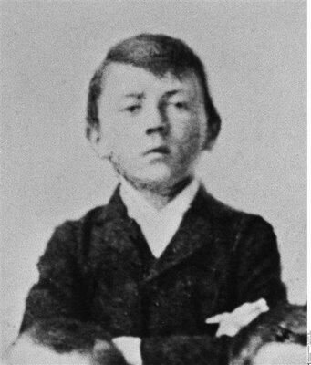
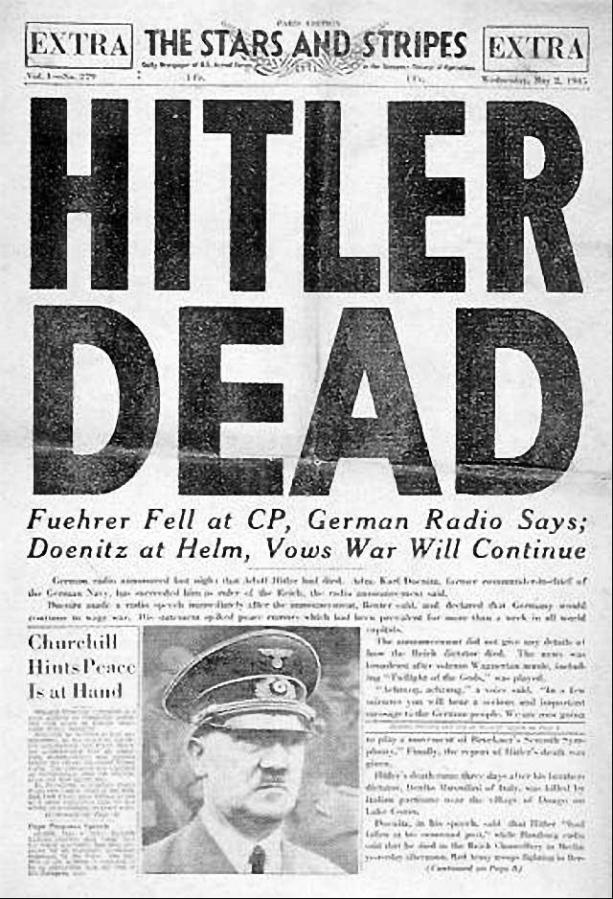
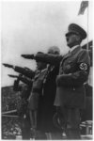
Adolf Hitler
Artifact 2
Artifact 3
Artifact 4
Back to Lobby

Slide 4
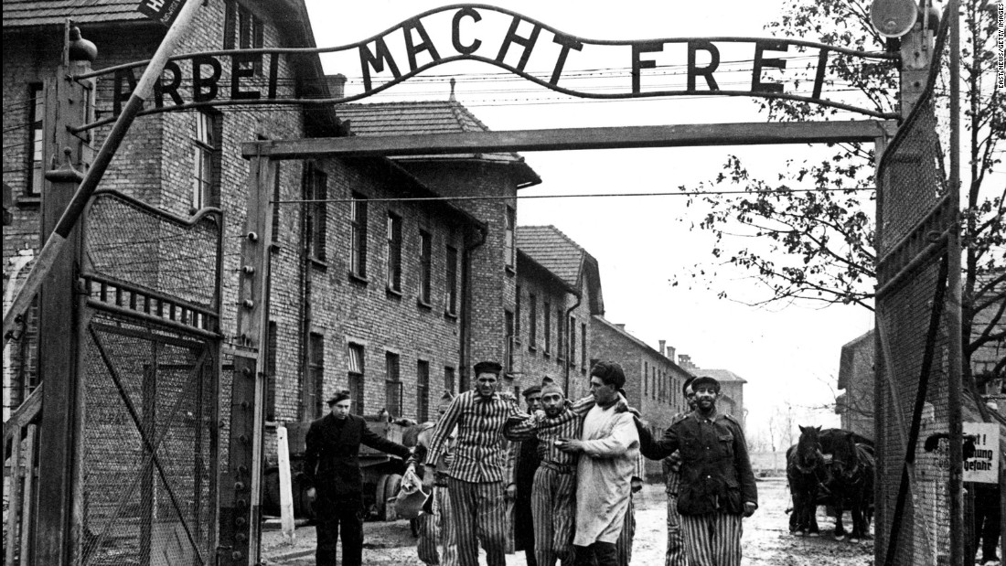
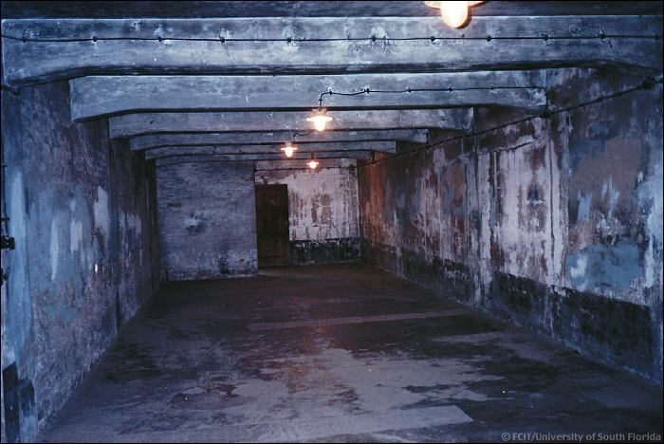
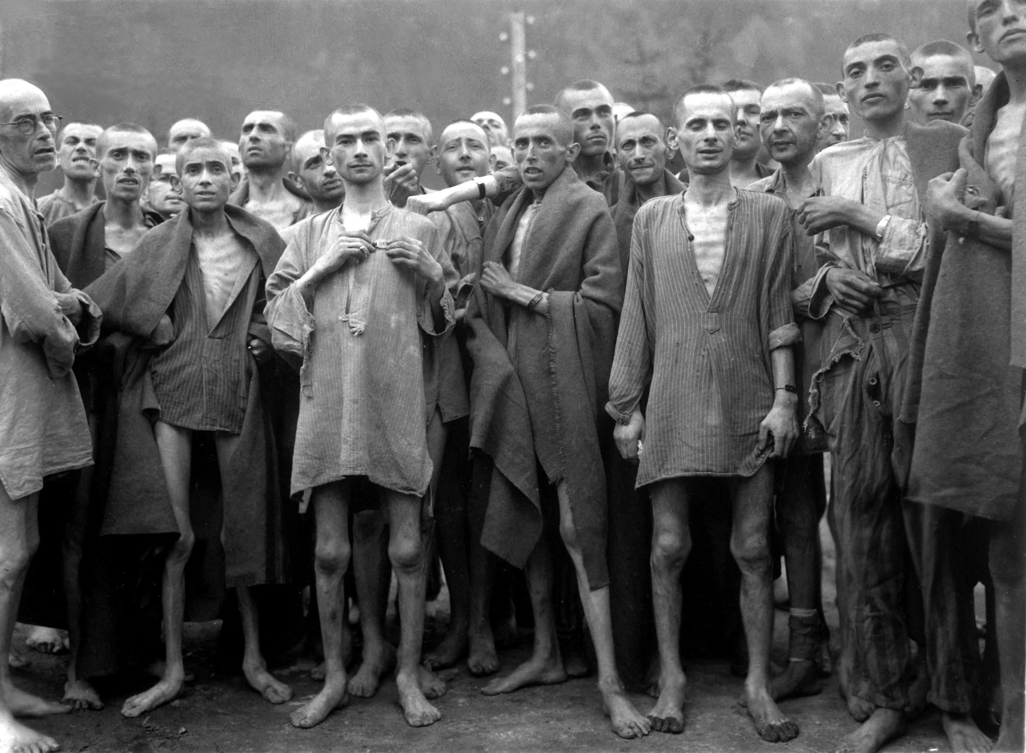
Concentration Camps
Artifact 6
Back to Lobby
Notes:
4

Slide 5
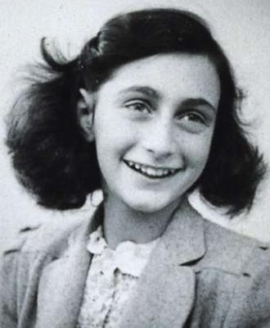
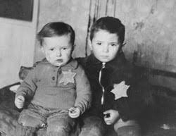
The Victims
Artifact 8
Artifact 9
Artifact 10
Back to Lobby
Notes:
5

Slide 6
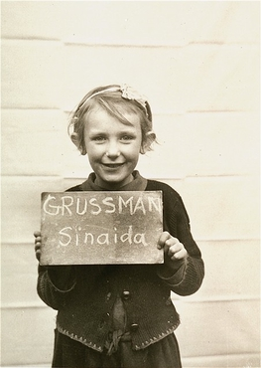
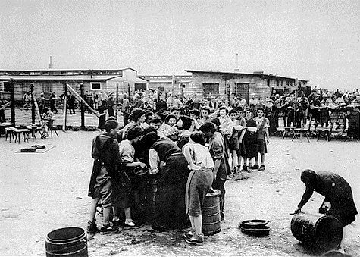
The Survivors
Artifact 12
Back to Lobby
Notes:
6

Slide 7
Hitler Before the War
Insert Artifact
Picture Here
Hitler was born on April 20th, 1889 in Braunau am Inn Austria. In, 1898 the Hitler family moved to Linz, Austria’s capital. Hitler wanted to pursue a career as an Artist, His Father wouldn’t let him and forced him to go into civil service. After his father’s death, Hitler asked his mother who was dying from breast cancer if he could live his dream as an artist in 1907. He took the entrance exam to Vienna Academy of the Arts but failed. After his mother’s death in late 1907 he moved to Vienna in hopes of gaining acceptance into the Arts Academy.Hitler lived in Vienna until May 1913 with a middle class family with few contacts with jewish people. Hitler inherited money from his parents as relatives offered to take him in but he turned them down and lived in countless homeless shelters and started a career in civil service. Once the money started to dry up he depended partly on the Jews that he had personal and business relationships with for his living.
Back to Room 1

Slide 8
Hitler During the War
Insert Artifact
Picture Here
Hitler came into power in 1933 and immediately started to make preparations for wars. The short term plan was weapons for western power as the long term focused on weapons for the U.S.
War with France and Britain were first. Hitler couldn't get Poland to join so he destroyed that country first. Hitler took over Norway and their Navy’s access to the North Arctic in April 1940. by June 1940 He had conquered France and started moving south. It was then that Hitler started plans for war with the US and Soviet Union. The German Invasion of the S.U. began June 22 1941. Hitler wanted Japan to join in on the war with Britain and in return Hitler would help Japan in the war with the U.S. Hitler declared war on the US in December of 1941.
Back to Room 1

Slide 9
Hitler After the War
Insert Artifact
Picture Here
On May 8th 1945 WW2 came to a close with Germany’s surrender. Hitler Believed the war was lost because of the “Collapse of the home front and therefore assumed that establishment of a dictatorship and the systematic killing of all the Jews would guarantee victory of this.”
Hitler married his mistress shortly after the war ended. Two days later he consumed poisons and later that day committed suicide with his wife.
Back to Room 1

Slide 10
Prisoners of the Camps:
Insert Artifact
Picture Here
Concentration camps were where people were imprisoned, tortured, and many times killed. Prisoners were required to wear color-coded triangles on their jackets, in order for guards and officers of the camps to identify each person's background easily. These people were forced to work, well they were being abused, and if they were not asked to work they were put to death.
Prisoners were jews, disabled people, catholics, homosexuals, and many more types of people. Six million Jews were killed throughout the concentration camps.
Back to Room 2

Slide 11
Gas Chambers:
Insert Artifact
Picture Here
There were many different types of concentration camps which included: labor camps, gassing, mass shooting, and medical testing extermination. Gas chambers were one of the most popular.
Gas chambers were used for the purpose of mass murdering starting around 1939. A poisonous gas would be filled in a room where prisoners were in. Many victims were killed this way during the Holocaust.
Back to Room 2

Slide 12
Auschwitz (1940-45):
Insert Artifact
Picture Here
Auschwitz was the largest concentration camp and the most notorious. It included three concentration camps that were all within Poland. A variety of means of death happened at this camps. It was estimated that 1.1 million people were killed at Auschwitz.
Many children would be immediately killed before arriving to Auschwitz. However, select children were chosen to be tested on.
Back to Room 2

Slide 13
Anne Frank
Anne Frank was a Jewish girl living during the time of the Holocaust. She and her family spent two years hiding, living in very tight quarters, from the Nazis. Throughout her time in hiding, she kept a diary with a wide variety of entries that later became published as “The Diary of Anne Frank.”
"Have you ever heard the term 'hostages'? That's the latest punishment for saboteurs. It's the most horrible thing you can imagine. Leading citizens--innocent people--are taken prisoner to await their execution. If the Gestapo can't find the saboteur, they simply grab five hostages and line them up against the wall. You read the announcements of their death in the paper, where they're referred to as 'fatal accidents'."
- October 9, 1942
Back to Room 3

Slide 14
Who Were The Victims?
Insert Artifact
Picture Here
During the Holocaust, the Nazis mainly targeted the Jews living during this time. The Nazis believed that they were “racially superior” to many other races, including the Jews. During the Holocaust, approximately 6 million innocent people were brutally murdered.
In order to identify the Jews of this time, the law stated that all Jews must wear the Star of David on their chest. This visibly set them apart from the rest, also making it easier to capture them.
Victims of the Holocaust located at Auschwitz concentration camp each were given a “new name.” This new name consisted of a series of numbers that were tattooed on their forearms. This became their new identity to the Nazis.
Back to Room 3

Slide 15
Not Only Jews
Insert Artifact
Picture Here
Along with Jews, many other races were victims of the Holocaust. This includes Gypsies, Mulatto Children, homosexuals, the disabled, Slavic people, and many more. Theses people were categorized of “Unworthy of Life.”
Towards the beginning of the Holocaust, any persons were captured and taken in if they opposed the Nazi’s view point.
Back to Room 4

Slide 16
Locating Surviving Relatives
This photo is of a girl in the Kloster Indersdorf children’s center located in Bavaria, only ten miles away from the Dachau concentration camp.This was an orphanage where Jewish and gentile children and teenagers of various nationalities were cared for together. This included those who were liberated from concentration camps and the people who had survived the Holocaust.
In October 1945 pictures like the one seen here were taken of most of the children who were at the center at the time. Each child is holding a name board in the photos. These were used in an attempt to help locate surviving relatives. They were published in newspapers to facilitate the reunification of families.
Back to Room 4

Slide 17
Eva Mozes Kor
Eva Mozes Kor is a survivor of the Holocaust twin experiments under Josef Mengele at Auschwitz. She was subject to human experimentation with her sister, Miriam. Eva along with her twin, mother, father, and two older sisters were at the camp. She and her twin were the only survivors of her family.
Mengele did a number of medical experiments, taking a special interest in twins. Eva recalls that she was given five injections at once from which she developed a high fever, and swollen appendages. She was given two weeks to live but she refused to die. She and her twin miraculously survived the medical experiments and last minute efforts by the Nazis to kill the prisoners of Auschwitz before it was liberated. The two sisters were moved to Israel after liberation and finally settled in the United States many years later.
Eva Mozes Kor is the author of books on her experience. She is also the founder of the group C.A.N.D.L.E.S - Children of Auschwitz Nazi’s Deadly Lab Experiments Survivors.
Back to Room 4

Slide 18
Women’s Camp at Mauthausen
Insert Artifact
Picture Here
Mauthausen Women’s Concentration Camp was established in order to exploit female prisoners’ labor for the war industries. They were forced to work in the ‘Wilhelm-Gustloff-Werk’ munitions factory or viscose production at the ‘Lenzing Zellwolle AG’ factory.
The official liberation day of the Mauthausen Concentration Camp by American Troops was May 5, 1945. There were approximately 60,000 survivors. This image is a picture of survivors in the Mauthausen women’s camp after liberation. They are lining up for soup.
Many of the survivors were weak and were no longer used to food. The American liberators handed out chocolate, soup, and other rich food to the survivors.
Back to Room 4

Slide 19
Standards
CCSS.ELA-LITERACY.RH.6-8.2
Determine the central ideas or information of a primary or secondary source; provide an accurate summary of the source distinct from prior knowledge or opinions.
CCSS.ELA-LITERACY.RH.6-8.7
Integrate visual information (e.g., in charts, graphs, photographs, videos, or maps) with other information in print and digital texts.
S.H.4.6-8.LC: Explain multiple causes and effects of historical events.
SS.IS.8.6-8.LC: Analyze how a problem can manifest itself and the challenges and opportunities faced by those trying to address it.
Back To Lobby

Slide 20
Resources
English Language Arts Standards » History/Social Studies » Grade 6-8. (n.d.). Retrieved October 21, 2017, from http://www.corestandards.org/ELA-Literacy/RH/6-8/
{{CurrentPage.Title}}. (n.d.). Retrieved October 21, 2017, from https://www.isbe.net/Pages/Social-Sciences-Learning-Standards.aspx
Adolf Hitler: Early Years, 1889–1913. (2017). Ushmm.org. Retrieved 22 October 2017, from https://www.ushmm.org/wlc/en/article.php?ModuleId=10007430
Cowley, R., & Parker, G. (2017). Adolf Hitler - World War II - HISTORY.com. HISTORY.com. Retrieved 22 October 2017, from http://www.history.com/topics/world-war-ii/adolf-hitler
Forced Labor: An Overview. (n.d.). Retrieved October 23, 2017, from https://www.ushmm.org/wlc/en/article.php?ModuleId=10005180
Back To Lobby

Slide 21
Resources
Mozes Kor, E. (2017). I survived the holocaust twin experiments. Buzzfeed. Retrieved October 23, 2017, from,
https://www.youtube.com/watch?v=gdgPAetNY5U
The Survivors  Photograph. (n.d.). Retrieved October 23, 2017, from http://www.ushmm.org/outreach/en/media_ph.php?ModuleId=10007736&MediaId=1018
Andlauer, A. (2015, December 6). Post war Children's Centers at Kloster Indersdorf. Retrieved October 23, 2017, from http://kloster-indersdorf-1945-48.blogspot.com/p/post-war-childrens-centers-at-kloster.html
Mauthausen Concentration Camp Survivors. (2009, June 18). Retrieved October 23, 2017, from http://www.scrapbookpages.com/Mauthausen/KZMauthausen/Survivors/index.html
https://www.holocaustcenter.org/holocaust-badges
https://www.ushmm.org/remember/the-holocaust-survivors-and-victims-resource-center/survivors-and-victims
Back To Lobby

