Slide 1
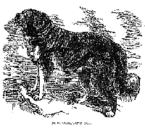
Museum Entrance
Lewis and Clark Historical Museum
Visit the Curators
Meet the Crew
The Louisiana Purchase
Native Americans
Discoveries, Geography, and Tools
Welcome to the Lobby

Slide 2
Alyssa Ried, Katie Deiner, Mary Voss
Hello! Welcome to our Virtual Lewis and Clark Historical Museum. The curators, Alyssa, Katie, and Mary are all students at Bradley University. This Museum was made following the rubric provided in ETE 335 – Social Studies Methods to give you the best information about Lewis and Clark as possible.
We hope you enjoy your visit!
Back to Lobby
Note: Virtual museums were first introduced by educators at Keith Valley Middle School in Horsham, Pennsylvania. This template was designed by Lindsey Warneka under the direction of Dr. Christy Keeler during a Teaching American History grant module. View the Educational Virtual Museums website for more information on this instructional technique.

Slide 3
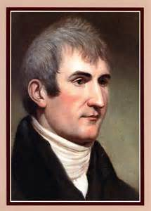
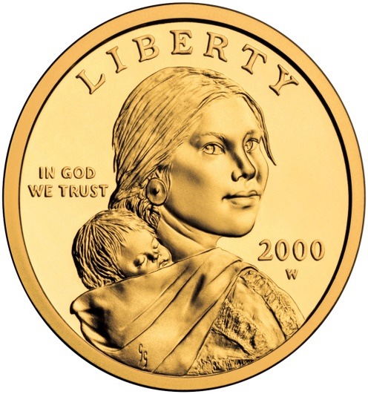
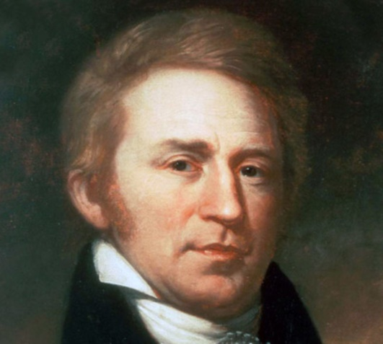
Meet the Crew
Back to Lobby

Slide 4
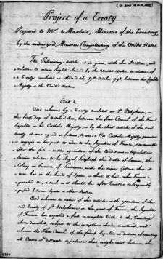
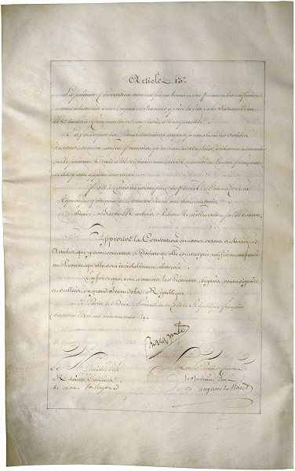
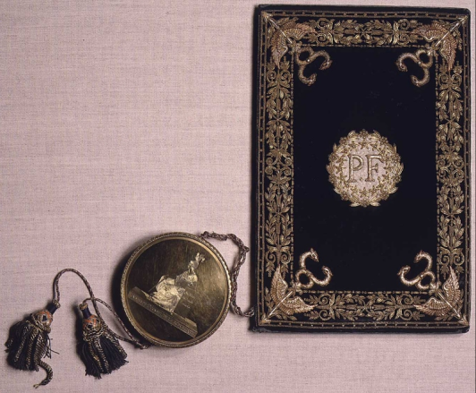
The Louisiana Purchase
Artifact 5
Artifact 6
Artifact 7
Back to Lobby
Notes:
4

Slide 5
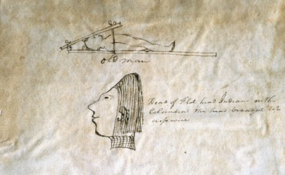
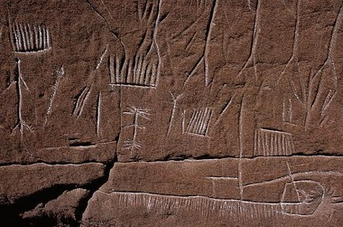
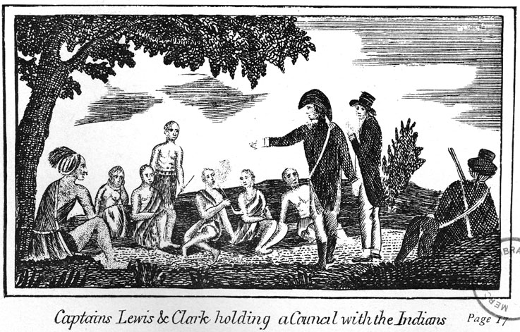
Native Americans
Back to Lobby
Notes:
5

Slide 6
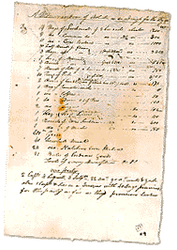
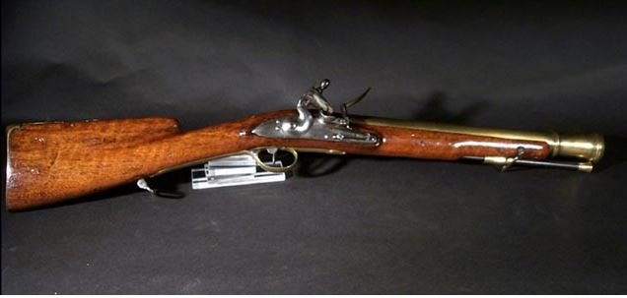
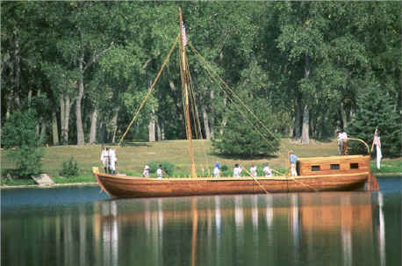
Discoveries, Geography, and Tools
Artifact 11
Artifact 12
Artifact 13
Back to Lobby
Notes:
6

Slide 7
Seaman
Insert Artifact
Picture Here
Pictured above is a drawing down by Lewis of his dog, Seaman.
In preparing for the expedition, Lewis visited President Jefferson’s scientific friends in Philadelphia for instructions in natural sciences, astronomical navigation and field medicine.
It is believed that it was during this period that Lewis, for “20$” purchased Seaman, his “dogg of the newfoundland breed” to accompany him to the Pacific.
Back to Room 1

Slide 8
Meriwether Lewis
August 18, 1774 - October 12, 1806
In 1801, Meriwether Lewis was asked to be President Thomas Jefferson’s private secretary.
Lewis was a member of the militia and helped to quell the Whiskey Rebellion. Later, he made Lewis the offer of leading an expedition of westward expansion.
Jefferson asked him to find out more about the plants, animals, and people that were in that region.
Back to Room 1

Slide 9
William Clark
August 4th 1770-September 1st 1838, born in Virginia
Lewis invited Clark to join on his expedition across the newly purchased territory.
He entered the military at age 19
Served with Lewis in the military in 1795
1796- retired from the military to manage his family’s estate
1803- got a letter from Lewis inviting him to join on an expedition exploring the west
Married Julia Hancock in 1808
1813- served as governor of the Missouri territory
Back to Room 1

Slide 10
Sacagawea
Pictured above is the United States Sacagawea Dollar coin minted in 2000. The United States wanted to commemorate Sacagawea for her part in our nation’s expansion.
She was a part of the Shoshone tribe.
She was able to act as a translator for the crew to communicate with other Indian tribes and help get through the terrain because she was more knowledgeable about it than Lewis and Clark.
Back to Room 1

Slide 11
Louisiana Purchase
Insert Artifact
Picture Here
Pictured above is an original document of the treaty for the Louisiana Purchase.
With the Louisiana Purchase in 1803, the United States purchased approximately 828,000,000 square miles of territory from France, thereby doubling the size of the young country.
What was known as Louisiana Territory stretched from the Mississippi River in the east to the Rocky Mountains in the west and from the Gulf of Mexico in the south to the Canadian border in the north.
Part or all of 15 states were eventually created from the land deal, which is considered one of the most important achievements of Thomas Jefferson’s presidency.
Back to Room 2

Slide 12
Louisiana Purchase
Insert Artifact
Picture Here
.
At the end of April the U.S. envoys agreed to pay $11,250,000 and assume claims of American citizens against France in the amount of $3,750,000.
The United States acquired the vast domain of Louisiana Territory, some 828,000 square miles of land.
The treaty was dated April 30 and signed on May 2.
In October, the U.S. Senate ratified the purchase, and in December 1803 France transferred authority over the region to the United States.
Back to Room 2

Slide 13
Aftermath of Louisiana Purchase
Insert Artifact
Picture Here
Pictured above is the cover letter for the Louisiana Purchase.
The acquisition of the Louisiana Territory for the bargain price of less than three cents an acre was among Jefferson’s most notable achievements as president.
American expansion westward into the new lands began immediately, and in 1804 a territorial government was established.
On April 30, 1812, exactly nine years after the Louisiana Purchase agreement was made, the first state to be carved from the territory–Louisiana–was admitted into the Union as the 18th U.S. state.
Back to Room 2

Slide 14
Clatsop Indians
The Clatsops aided the Corps both in preparing for and dealing with the Northwest winter.
Relations between the Clatsops and the expedition went well through the duration of the Americans’ stay.
The sketch above was drawn by William Clark, he drew their sloped foreheads, which was unfamiliar to him.
Back to Room 3

Slide 15
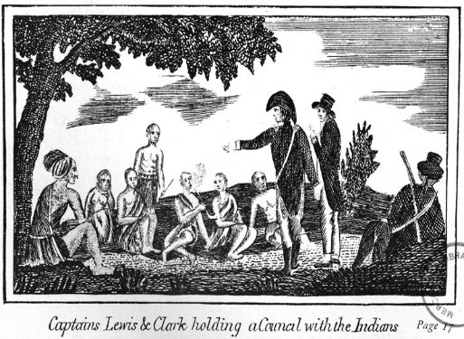
Missouri Indians
On August 2 1804, a small group of Missouris and Otos arrived at the Corps’ camp site, which Clark had named Council Bluff - across and downriver from what is now Council Bluffs, Iowa.
During the council, the Indians were told they were the “children” of a new “great father” who would provide them with trade and protection.
It was a speech Lewis would deliver to numerous tribes throughout the journey.
Back to Room 3

Slide 16
Shoshone Indians
Insert Artifact
Picture Here
Pictured above is a Shoshone tribe carving on rock
Shoshone Indians were also known as the Snake Nation
The Shoshone tribe occupied the areas east and west of the rocky mountains where Lewis and Clark had traveled
On August 13th, women gathering food saw 4 strangers - it was Lewis and his men. The women were fearful of Lewis and his men until he dropped his gun as a sign of peace. Lewis and his men were the first white people the Shoshone women had ever seen
Sacagawea was kidnapped from the Shoshone tribe and when they visited the tribe she realized she knew these people.
They went to join Clarks camp and Cameahwait (Sacagawea's brother) helped negotiate for horses
The Shoshone Tribe wanted to secure guns in return
Back to Room 3

Slide 17
List of Tools
Insert Artifact
Picture Here
Lewis and Clark spent a total of $2,324 on gear.
The supplies they used included boats and oars, camping equipment, clothing such as flannel shirts and coats, medicine like syringes and diaphoretic,15 prototype model 1803 muzzle-loading .54 caliber rifles “Kentucky Rifles,” mathematical instruments, presents for Indian tribes encountered, and books, tables, and maps.
Back to Room 4

Slide 18
Keelboat
Insert Artifact
Picture Here
Pictured above is not the exact boat Lewis and Clark used on their voyage, but it is the type of boat that they would have used.
Lewis and Clark traveled on a 55 foot Keelboat. The boat could be rowed, paddled or sailed. They also took along two pirogues, or rowboats, for men and extra supplies to travel in alongside the keelboat.
Back to Room 4

Slide 19
Blunderbusses
Insert Artifact
Picture Here
The Lewis and Clark expedition was in many ways an infantry company on the move, fully equipped with rifles of various kinds, muskets, and pistols.
Among the firearms were two blunderbusses. Named after the Dutch words for “thunder gun,” the blunderbuss was unmistakable for its heavy stock, short barrel, and wide-mouthed muzzle.
Other expedition guns might be graceful in design and craftsmanship but the stout blunderbuss simply signified brute force and power.
Lewis and Clark fired their blunderbusses as signs of arrival when entering Indian camps or villages.
Back to Room 4

Slide 20
Standards
D2.Geo.11.6-8. Explain how the relationship between the environmental characteristics of places and production of goods influences the spatial patterns of world trade.
D2.His.14.6-8. Explain multiple causes and effects of events and developments in the past.
CCSS.ELA-Literacy.RH.6-8.2 Determine the central ideas or information of a primary or secondary source; provide an accurate summary of the source distinct from prior knowledge of opinions.
CCSS.ELA-Literacy.RH.6-8.7 Integrate visual information (e.g., in charts, graphs,photographs, videos, or maps) with other information in print and digital texts.
Back to Room 4

Slide 21
Resources
Rivers, Edens, Empires: Lewis & Clark and the Revealing of America Lewis & Clark. (n.d.). Retrieved October 15, 2016, from https://www.loc.gov/exhibits/lewisandclark/lewis-landc.html
Biography.com Editors. (2016, October 10). William Clark. Retrieved November 1, 2016, from http://www.biography.com/people/william-clark-9542620
History.com Staff. (2009). Lewis and Clark. Retrieved November 5, 2016, from http://www.history.com/topics/lewis-and-clark
Lewis & Clark Expedition. (2016, September 7). Retrieved November 1, 2016, from https://www.archives.gov/education/lessons/lewis-clark
Mandan Indians. (n.d.). Retrieved November 07, 2016, from http://www.pbs.org/lewisandclark/native/man.html
Primary Source Set Westward Expansion. (n.d.). Retrieved November 1, 2016, from http://library.mtsu.edu/tps/sets/Primary-Source_Set--Westward-Migration.pdf
Seamen. (n.d.). Retrieved November 07, 2016, from http://www.pbs.org/lewisandclark/inside/seaman.html
Back to Room 4

Slide 22
Resources
Lewis and Clark History. (n.d.). Retrieved November 08, 2016, from http://lewisandclarktrail.com/keelboat.htm
Avey, T. (2013). What Lewis and Clark Ate. Retrieved November 08, 2016, from http://www.pbs.org/food/the-history-kitchen/what-lewis-and-clark-ate/
National Geographic: Lewis & ClarkTribesShoshone Indians. (n.d.). Retrieved November 08, 2016, from http://www.nationalgeographic.com/lewisandclark/record_tribes_ 017_11_8.html
Back to Room 4

