Slide 1
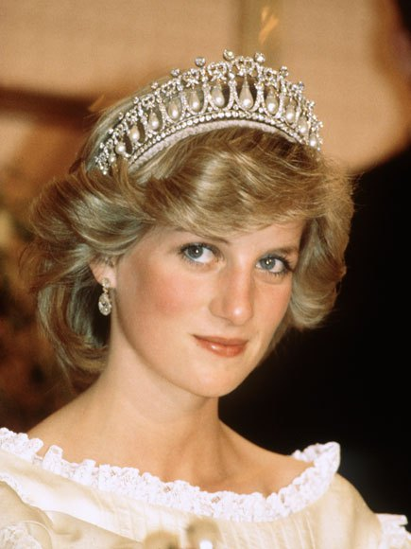
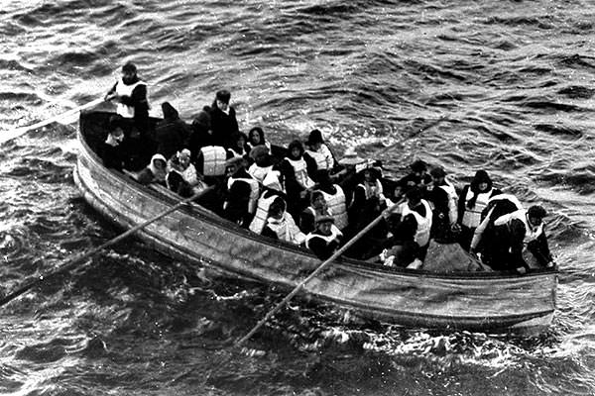
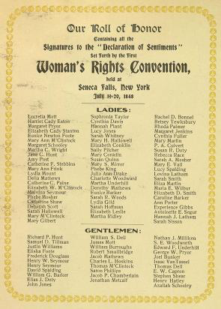
Museum Entrance
Welcome to the Women in History Museum
Press
For Curator
Sports Room
Art Room
ScienceRoom

Slide 2
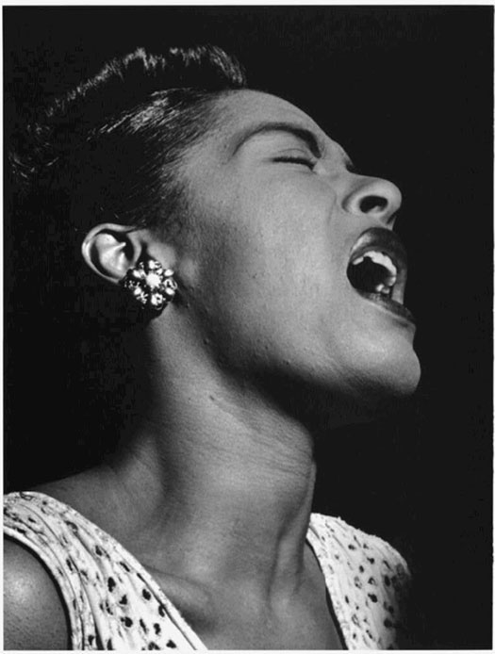
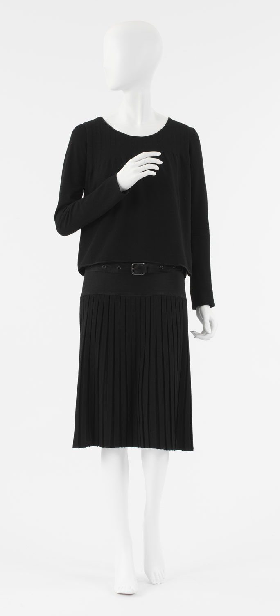
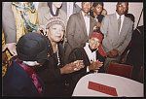
Room 2
Add Artifact 6
Add Artifact 8
Add Artifact 5
Art Room
Add Artifact 7
Museum Entrance

Slide 3
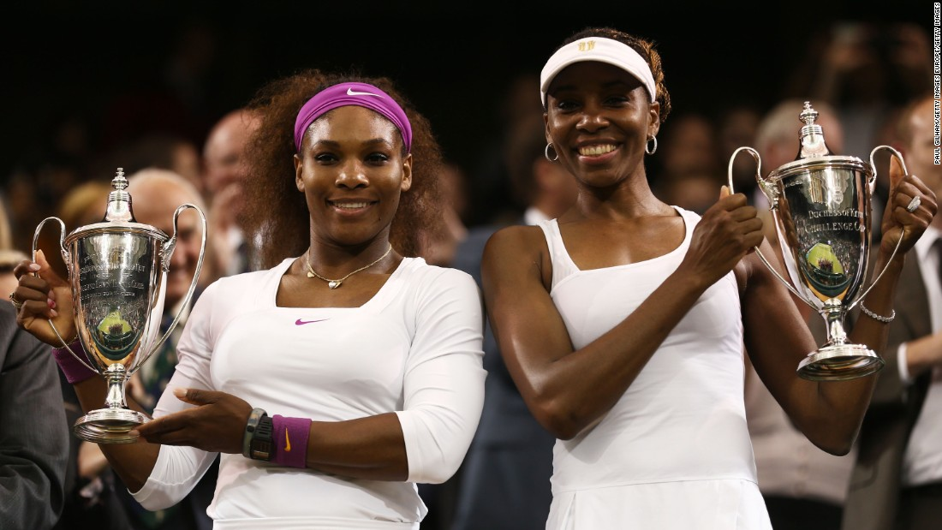
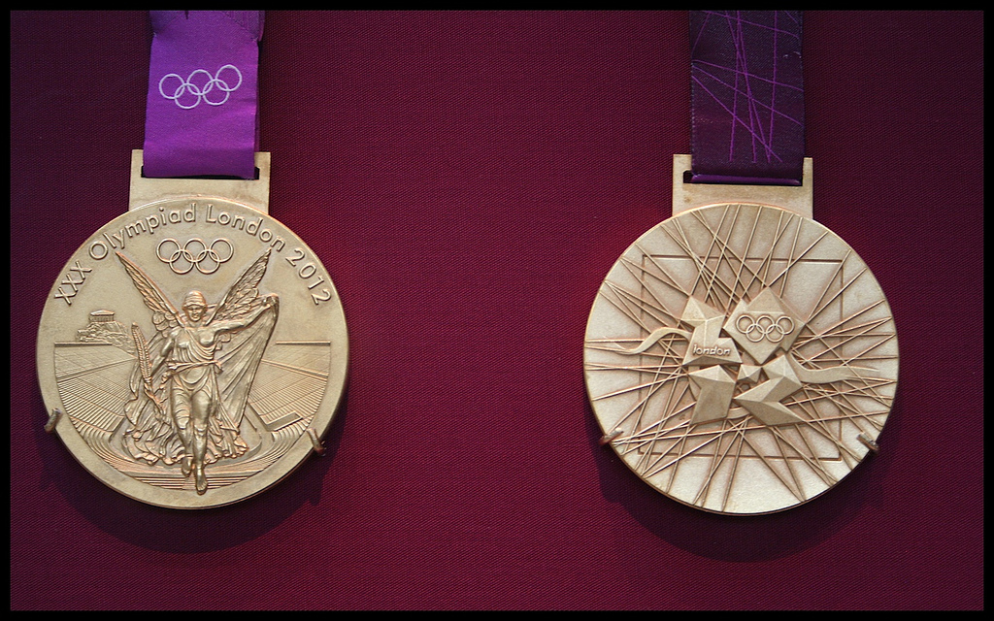
Room 3
Add Artifact 10
Add Artifact 11
Sports Room
Museum Entrance

Slide 4
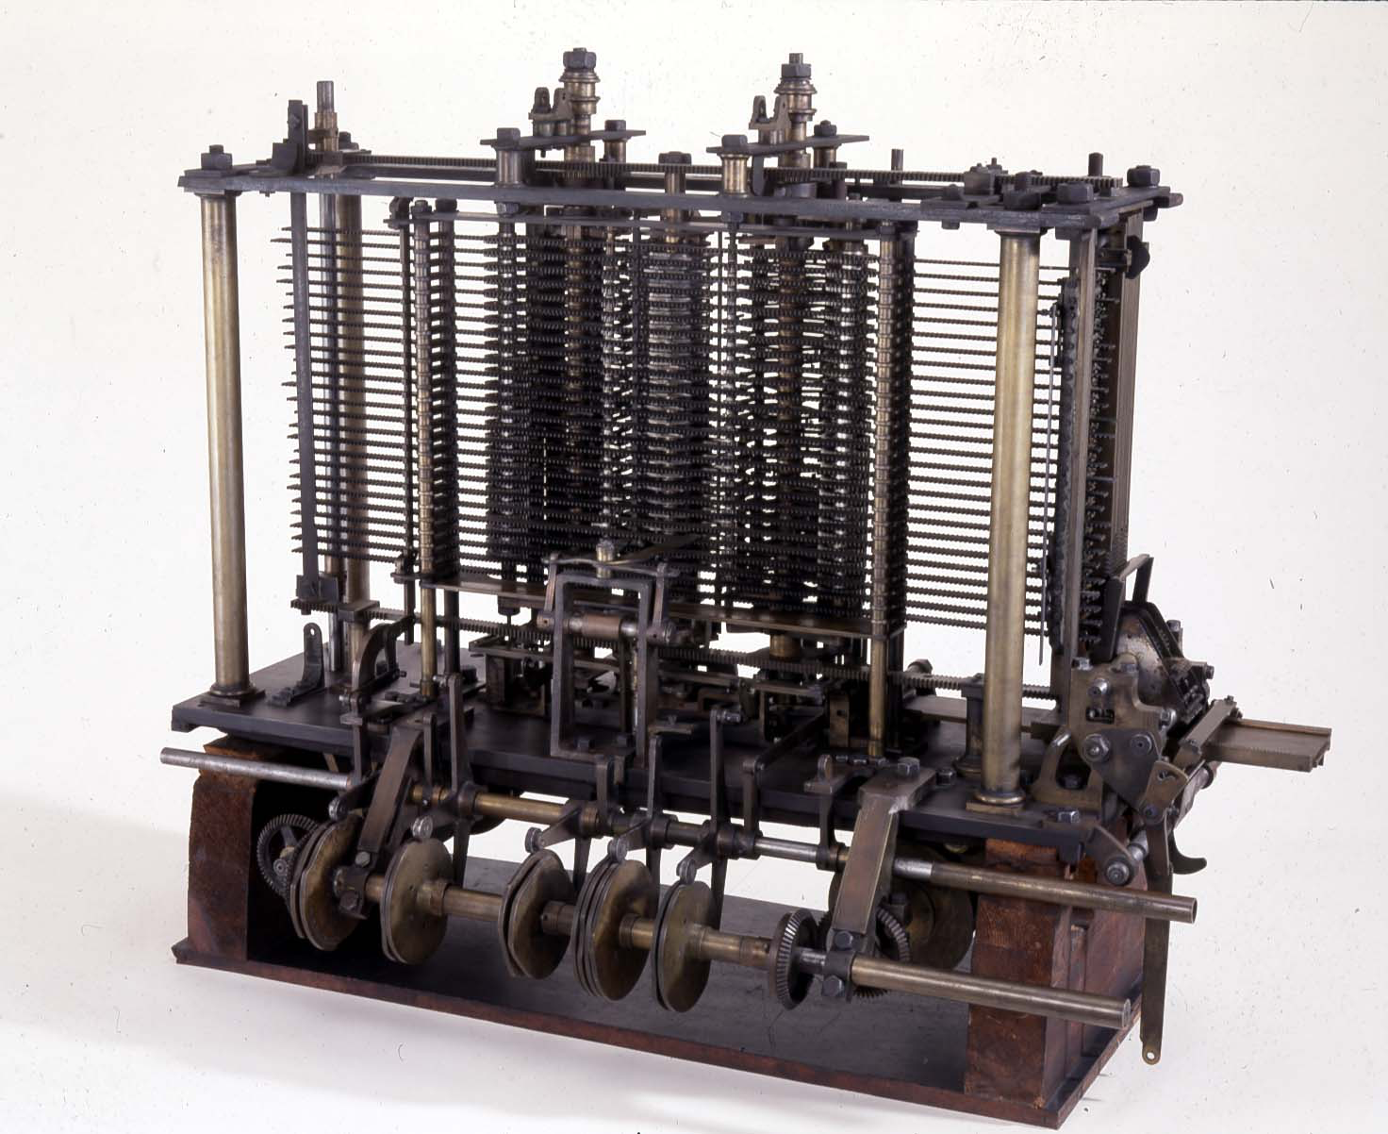
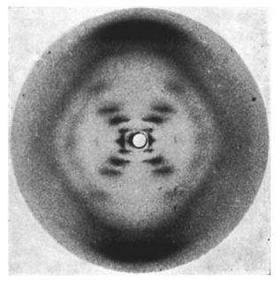
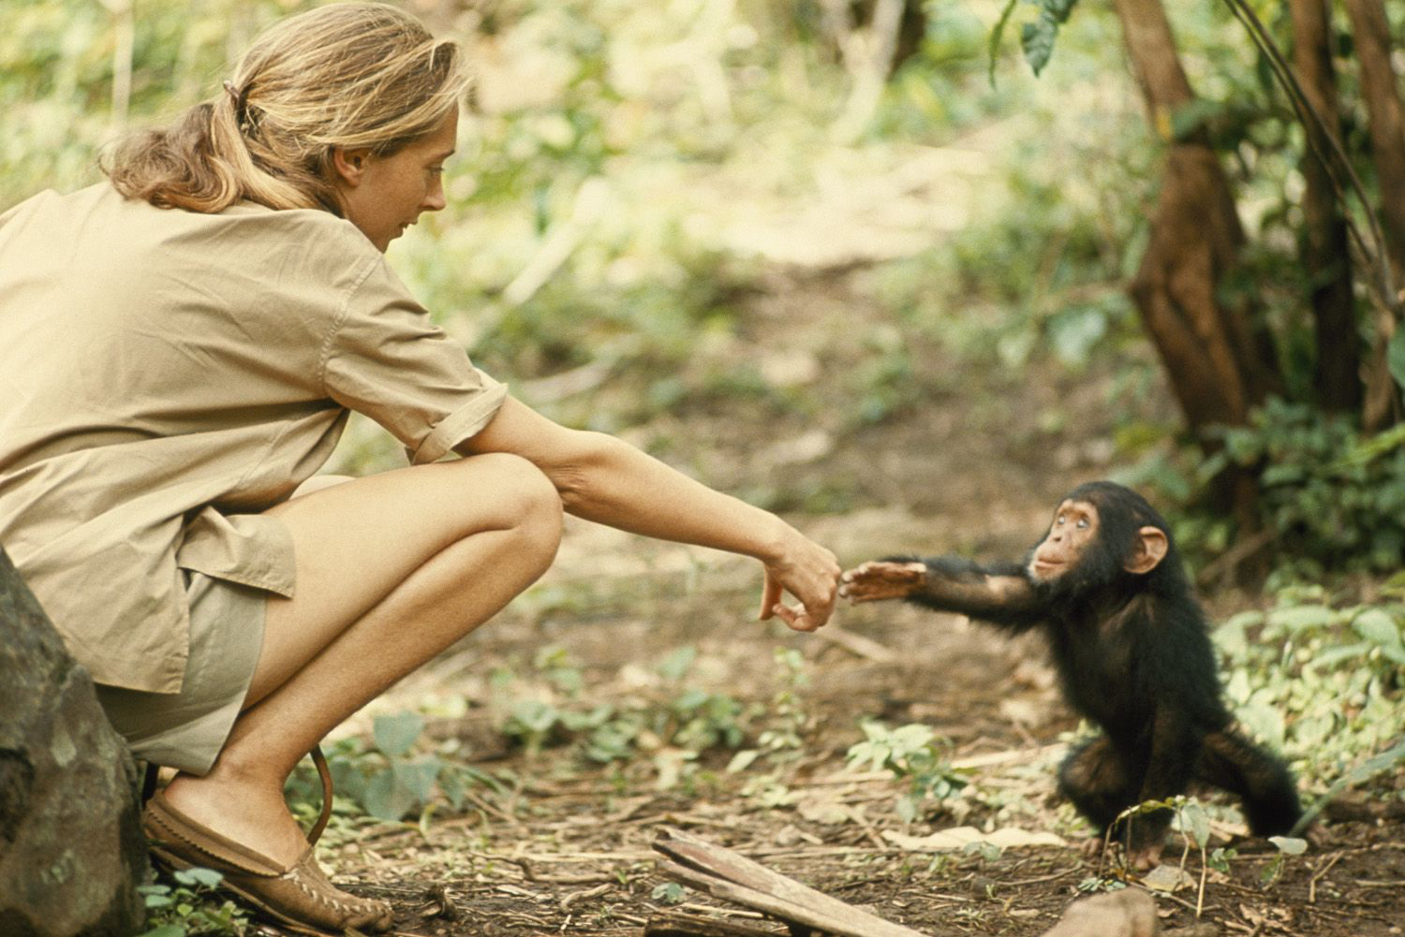
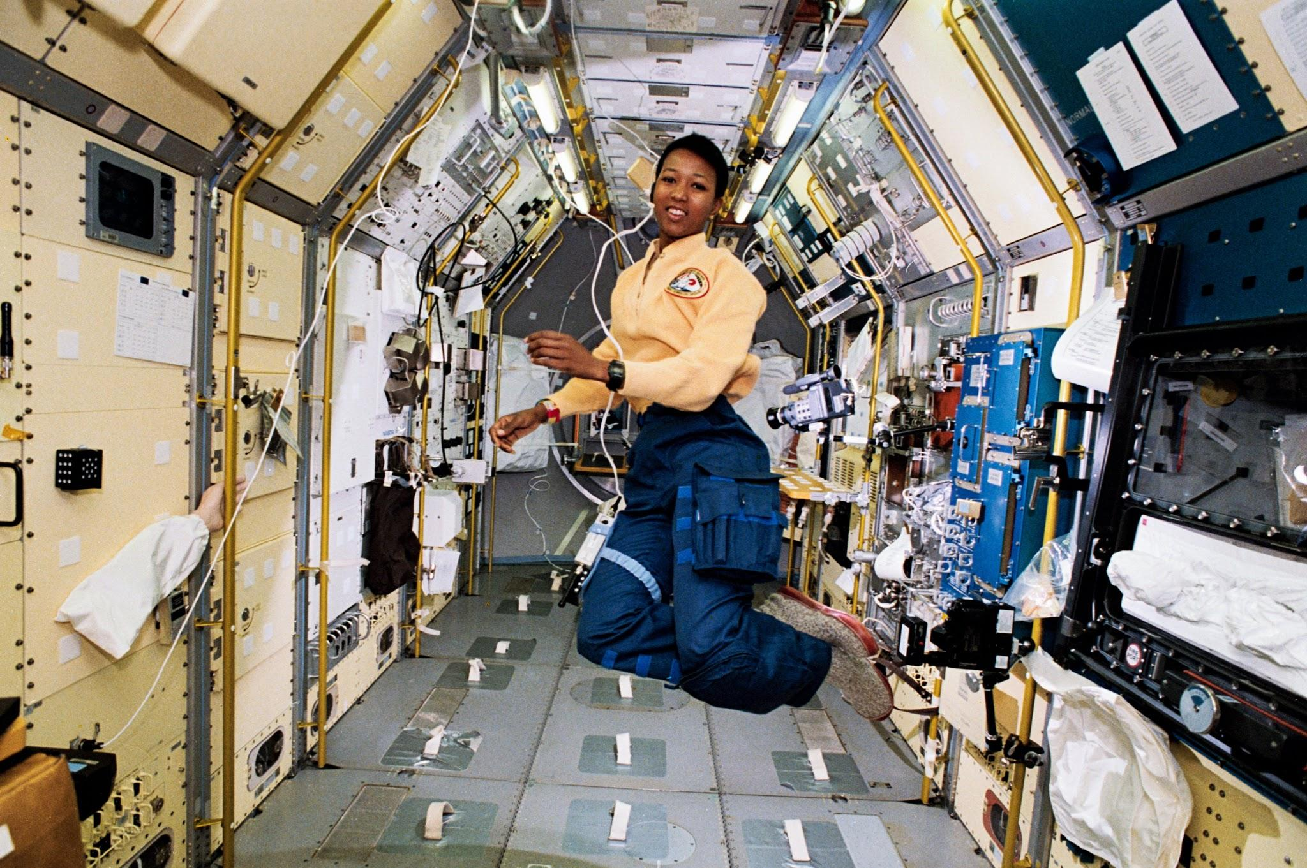
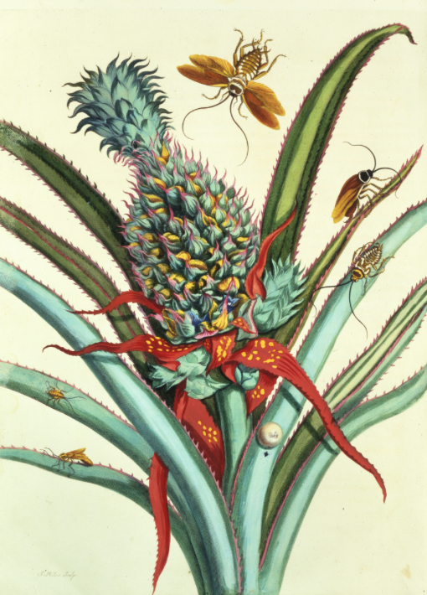
Room 4
Mathematics and science room
Add Artifact 16
Add Artifact 13
Add Artifact 14
Add Artifact 15
Optional Artifact 17
Museum Entrance

Slide 5
Princess Diana and the Cambridge
Lover’s Knot Tiara
Diana Spencer was born on July 1, 1961 and later became Princess of Wales when she married Prince Charles in 1981. She became widely known as the "People's Princess" due to her widespread popularity and global humanitarian efforts. She worked to raise awareness of the dangers of landmines, HIV and AIDS, leprosy, homelessness, children’s health and other causes that had never been taken on by the Royal Family before. On August 31, 1997, Diana tragically died from injuries she sustained in a car crash in Paris.
The Cambridge Lover’s Knot Tiara, as shown in the picture, is one of the best known tiaras in the British royal family’s collection and was originally commissioned by Queen Mary from famous court jewelers Garrard in 1913 or 1914. It is a replica of a 200-year-old Gothic Revival tiara owned by Mary’s grandmother, Princess Augusta of Hesse, the Duchess of Cambridge, but is known as the late Princess Diana’s favorite tiara. The tiara is a part of the personal collection of Queen Elizabeth II and was loaned to Diana each occasion she wore.
Image acquired at:
https://www.biography.com/people/princess-diana-9273782
Return to Room

Slide 6
The Seneca Falls Convention
In July 1848, nearly 300 people met for two days for the first formal women’s rights convention ever held in the United States. These people who met in Seneca Falls, New York, included 68 women and 32 men who signed a document known as the “Declaration of Sentiments,” which stated: “We hold these truths to be self-evident, that all men and women are created equal, that they are endowed by their Creator with certain inalienable rights, that among these are life, liberty, and the pursuit of happiness; that to secure these rights governments are instituted, deriving their just powers from the consent of the governed.”
Those who wrote the document were inspired by the original Declaration of Independence, and their boldness inspired the organization of a women’s rights movement in the United States. The Seneca Falls Declaration of Sentiments tied women to the pre-existing American natural rights tradition and challenged Americans to include women in democracy.
The document is a list of signers of the Declaration of Sentiments, known as the “Roll of Honor.” Notable names include Elizabeth Cady Stanton and Lucretia Mott, both major players in the story of American women.
Image acquired at:
https://www.gilderlehrman.org/history-by-era/first-age-reform/essays/seneca-falls-convention-setting-national-stage-for-women’s-su
Return to Room

Slide 7
Molly Brown and the Titanic
Margaret "Molly" Brown was born on July 18, 1867. She is known as an American socialite and philanthropist. However, she is best known as "The Unsinkable Molly Brown". She earned this title for exhorting the crew in Lifeboat No. 6 to return to the debris field of the 1912 sinking of RMS Titanic to look for survivors. Brown even helped others board the lifeboats, refusing to board one herself before others were safe. The passengers on her lifeboat boarded the rescue ship Carpathia. Once on the ship, Brown immediately began work to help other survivors of the wreck and by the time the ship docked in New York, she had established the Survivor’s Committee, been elected chairperson, and had raised almost $10,000 for the impoverished survivors.
The picture on the right is of the Titanic collapsible lifeboat D approaching the rescue ship Carpathia. It is the same type of lifeboat that Brown would have boarded. The Titanic only had enough lifeboats to accommodate 33% of the ship’s total passengers and crew. Brown’s bravery helped save lives and made history.
Image acquired at:
http://www.titanicfacts.net/titanic-lifeboats.html
Return to Room

Slide 8
Abigail Adams and her Letters
Born on November 11, 1744, Abigail Adams would eventually become the wife of second President John Adams and mother of sixth President John Quincy Adams. She is best known for her work as an unofficial advisor to John Adams. There are even letters that show John Adams seeking her counsel on many issues, including his presidential aspirations. Her work in politics helped to shape the nation during her husband’s presidency. One letter famously encouraged her husband to, “Remember the ladies.”
The letter shown is written by Abigail to John Adams. Abigail demonstrates her interest in politics by talking about the Virginia colonies and their defences. She also mentions fearing smallpox in Boston which shows another aspect of the time period that the letter was written in. Her work helped to support women in politics.
Image acquired at:
https://www.masshist.org/digitaladams/archive/doc?id=L17760331aa
Return to Room

Slide 9
Sappho and her Legacy
Sappho was born around 615 B.C. to an aristocratic family on the Greek island of Lesbos. Not much is known about her life, but evidence suggests that she had several brothers, was married to a wealthy man named Cercylas, and had a daughter named Cleis.
She is known as one of the first women poets. Her work includes language that contains elements from Aeolic vernacular speech and Aeolic poetic tradition. Much of her work demonstrates allusions to the political disturbances of the time. She also focused on themes involved with the female community. One of Sappho’s main goals was to educate women.
The photo shown is a painting made to show what Sappho might have looked like when she was alive. It was made between 1870 and 1911 by Edwin Austin as a way to pay homage to a woman dedicated to the education and betterment of other women.
Image acquired at:
https://www.loc.gov/item/2010714806/
Return to Room

Slide 10
Billie Holiday and Jazz
On April 7, 1915, Eleanora Fagan was born in Baltimore, Maryland. Elenora would later go under the stage name, Billie Holiday, and become one of the greatest jazz singers of all time. Her vocal style, strongly inspired by jazz instrumentalists, pioneered a new way of manipulating phrasing and tempo even without receiving any formal musical training. She was known for her vocal delivery and improvisational skills. She unfortunately lost her battle to substance abuse and died in 1956 at the age of 44.
The tension of racism was a powerful subtext to Holiday’s life story. Due to the Jim Crow laws that were still in effect through most of her career, Holiday occasionally often found herself in the ironic situation of being the featured vocalist in clubs that refused to serve blacks.
The portrait is of Holiday singing at the Downbeat Club in New York, NY. Through a difficult childhood and a career filled with racism, Billie Holiday was able to become one of the most influential jazz musicians of all time.
Image acquired at:
https://www.loc.gov/item/today-in-history/april-07/
Return to Room

Slide 11
Maya Angelou and Activism
Born on April 4th, 1928, Maya Angelou was to become an American poet, memoirist, and civil rights activist. Throughout the span of 50 years, Angelou was able to publish seven autobiographies, three books of essays, several books of poetry, and was credited with a list of plays, movies, and television shows. She received dozens of awards and more than 50 honorary degrees. Her work shined a light on civil rights for African American as well as for women.
The photo is of Rosa Parks (seated left), Maya Angelou (seated in the middle), Elaine Steele (seated right) and others, in Washington, D.C. for the Million Man March in 1995. The march was to unite in self-help and self-defence against economic and social ills within the African-American community. She worked to create a nation full of equal opportunities no matter what your race or gender.
Image acquired at:
https://www.loc.gov/item/2015652104/
Return to Room

Slide 12
Coco Chanel and the Little Black Dress
Gabrielle “Coco” Chanel overcame her rough childhood to become not only one of the best well known fashion designers in the world, but a style icon. The business woman opened her first store in Paris in 1910 by selling hats. With the success of her hat business, Chanel used her sewing skills to design and create clothing. She designed clothing that she would want to wear herself. Chanel revolutionized the idea of a women’s suit and “little black dress”. Chanel still expanded on her empire by launching her first perfume “Chanel No. 5.” Chanel’s goal was to make women feel beautiful in her clothing designs. To this day, Chanel is still regarded as a prominent fashion icon.
This artifact displays Chanel’s creation of the “little black dress”. The dress is made out of a jersey fabric, which Channel incorporates in most of her clothing creations because of the comfort of the material.
Image acquired at:
https://www.metmuseum.org/toah/works-of-art/1984.28a-c/
Return to Room

Slide 13
Misty May-Treanor and Kerri Walsh Jennings’ Medals
Misty May-Treanor and Kerri Walsh Jennings are worldly recognized as the greatest women's volleyball tandem in history. The dynamic duo have competed in 3 different olympics and 4 different world championship games, winning the gold medal in all of them. The duo held a 32 game winning streak during olympic competition before calling it quits after the 2012 Olympics in London. In between Olympic competition, the tandem competed in the FIVB international tour where they won multiple international championship representing USA. The duo received team of the year honors after having an undefeated domestic season of winning 39 consecutive matches. The duo had a reign of dominance over the sport of beach volleyball for almost 12 years where they had a win streak of 112 matches and 17 straight tournament championships.
This artifact displays a gold medal that was handed to both May and Walsh in the 2o12 Olympics in London. To this day, there has never been a reign of dominance over a sport like these two women had. Listed below is a link to a video of May and Walsh showing their dominance in the gold medal game in the 2012 olympics.
https://www.youtube.com/watch?v=m9PdBs6ub1M&t=3849s
Image acquired at:
http://maxileadmetals.co.uk/what-are-the-olympic-gold-medals-really-made-from/ l
Return to Room

Slide 14
Becky Hammon and her Awards
Born on March 11, 1977 in Rapid City, South Dakota, Becky Hammon is not only one of the greatest WNBA players to ever play but also is the first to break down multiple gender lines within the sport of basketball. Hammon played 15 years in the WNBA, playing for the New York Liberty and the San Antonio Silver Stars. She is a 6x WNBA All-Star, been selected 1st team all WNBA twice, and won a silver medal in the 2008 Olympics. Since her retirement in 2014, Hammon has been breaking down gender lines within the sport of basketball. She is the first woman to be hired as an assistant coach becoming the first full time, salaried, female coach in NBA history. In 2017, Hammon became the first woman ever to lead a team to a summer league championship in a male sport. Hammon continues to break down gender lines as she continues her pursuit of becoming the first female head coach in NBA history.
This photograph was taken the day of Hammon’s press conference where she was introduced as the first women's basketball coach in league history. Listed below is a link to view the press conference in its entirety.
https://www.youtube.com/watch?v=fVueTnkCJ3A
Image acquired at:
http://abcnews.go.com/Sports/becky-hammon-talks-locker-rooms-history-making-role/story?id=25016415
Return to Room

Slide 15
The Williams Sisters and their Trophies
Worldly recognized as two of the greatest tennis players to ever step on a court, Serena and Venus Williams have broken down several racial and gender barriers that have plagued the sport of Tennis. While the Williams sisters both have incredible athletic resumes and dominated the sport of Tennis for almost two decades, perhaps their greatest achievements have been accomplished off the court. Serena was the first African American woman to be ranked #1 by the Women's Tennis Association. Together, the sisters have pushed for reform around the world to gain equal pay for athletes regardless of sex. They are also the first African American Women to be part owners of an NFL franchise, as they are part owners of the Miami Dolphins. The Williams sisters are true role models of how to fight against the national issue of oppression. To this day, the sisters continue to work and fight for minorities and continue to push for equality.
The photograph is of the Williams sisters accepting their trophies at the Women's Challenge Cup Championship after a dominating performance. Below is a link of the Williams sisters winning Olympic doubles gold at the 2012 Olympics in London.
https://www.youtube.com/watch?v=QJ0sgdZEALk
Image acquired at:
http://sportslegal.co.ke/2016/10/25/serena-and-venus-the-tennis-greatest/
Return to Room

Slide 16
Kerri Strug and her Victory
Born on November 19, 1977 in Tucson Arizona, Kerri Strug is one of the most iconic women in Olympic history. At the age of 3, Strug’s parents started her training for gymnastics where she eventually started competing competitively at the age of 8. Realizing that her dream of competing in the Olympics was becoming a realistic goal, Strug left Arizona and moved to Houston, Texas to be trained by Bela Karolyi. After years of intense training Strug made her way to the 1992 Olympics in Barcelona where she helped represent team USA winning a bronze medal. Strug is most known for her inspiring performance on the vault in the 1996 Olympics. Strug went up for her first attempt on the vault and came down breaking her ankle. In order for team USA to clinch the gold medal against Russia, Strug needed to vault one more time and stick her landing. She courageously fought through immense pain and structural damage and vaulted one last time sticking her landing on a broken ankle to win the gold for team USA.
The photograph shown is trainer Bela Karolyi carrying Strug with her broken ankle as she accepts her gold medal. Kerri Strug’s performance is considered one of the greatest moments in Olympic history and became a national icon for what it means to have heart, determination, and passion for one’s country. Below is a link of Kerri Strug’s historic performance.
https://www.youtube.com/watch?v=C_Wf6xKU3eI
Image acquired at:
http://tucson.com/kerri-strug/article_a3cd7e06-5c47-11e7-aecc-a78ef3582dbc.html
Return to Room

Slide 17
Ada Lovelace’s Computing Machine
Augusta Ada Byron Lovelace was born into a wealthy family and loved math from a young age. A childhood sickness left her bedridden for several years, and she used that time to learn all she could about mathematics. At age 17, Ada met mathematician Charles Babbage. Many years later the two collaborate on a machine that was designed to be smarter than any calculator. Ada’s role was to translate Babbage’s notes and research. As she did so, she annotated his notes with her own research. While doing so, Ada created and described the very first computer program. The notes Ada Lovelace created have inspired many modern computer programs.
The machine at the right is Babbage’s original “Analytical Machine.” The machine was based around a series of punch cards, which Ada Lovelace sequenced to return a specific set of numbers. Modern computers may look very different, but the principles used in this machine are still applied today.
Image acquired at:
http://www.computerhistory.org/atchm/ada-lovelace-day-2/
Return to Room

Slide 18
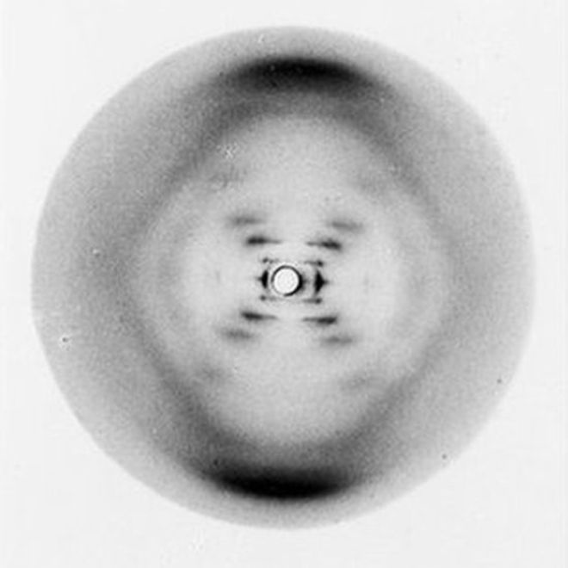
Rosalind Franklin and Photograph 51
Rosalind Franklin was an English Chemist and x-ray crystallographer best known for her x-ray diffraction images on DNA which led to the discovery of the shape of DNA. She studied chemistry at Newnham College in Cambridge where she graduated second in her class, later earning a PhD in physical chemistry from Cambridge University. Franklin used her expertise in the different techniques on x-ray diffraction to improve the pictures that were being taken of the DNA fibers. After working many days and hours, she captured a photo that proved DNA has a double helix shape. Two other scientists, James Watson and Francis Crick had been trying to figure out what shape DNA was. They looked at Franklin’s work without her permission and used her findings to publish their own work without giving her any credit, meaning her work was overlooked. Watson and Crick earned the Nobel Prize in Chemistry after Franklin passed away, and her contribution was unknown for years.
The image at the right is the infamous Photograph 51, taken in May 1952. The basic double-helix structure of DNA was caught on film for the very first time.
Image acquired at:
http://www.bbc.com/news/health-18041884
Return to Room

Slide 19
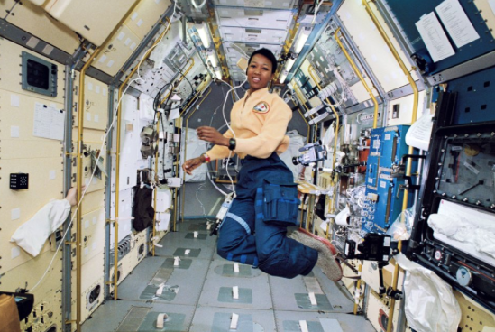
Mae Jemison in Space
Mae Jemison is an American engineer, physicist and astronaut. Before becoming an astronaut, Jemison worked as a doctor with the Peace Corps. She is most known for becoming the first African American woman in space when she went into orbit on the space shuttle Endeavor in September of 1992. An interesting facet of her flight is she took a sorority flag, and West African statue, and a poster of Judith Jamison in order to represent women in African American culture in space. This is especially important because Dr. Jemison recalls watching the Apollo missions as a child and not seeing anyone like her going into space. Jemison would resign from NASA in 1993 to found her own company, The Jemison Group, which researches and develops science and technology for everyday life. Dr. Jemison is also involved in the 100 Year Starship Project, whose goal is to have humans traveling to the next solar system within 100 years.
The photograph at the right shows Mae Jemison onboard the Earth-orbiting space shuttle Endeavor in September 1992 as a STS-47 mission specialist.
Image acquired at:
http://time.com/collection/firsts/4883293/mae-jemison-firsts/
Return to Room

Slide 20
Dr. Jane Goodall and her Chimps
Dr. Jane Goodall studied chimpanzees in Tanzania at the Gombe Stream National Park. She helped the world learn more about chimpanzees and led the fight to help save them from extinction.
While studying chimps in their natural habitat, Dr. Goodall proved that animals make and use tools. Before Goodall’s findings, it was thought that only humans created tools to help in everyday life. David Greybeard, a chimp who Goodall observed, was trying to eat termites out of a termite mound. Goodall respectful watched as they animal struck a tree branch down the termite mound. The result was a branch full of termites, a chimps favorite food. This is only one of the observations Goodall made about chimpanzees. Dr. Goodall helped the world learn more about a wonderful animal in our world. Today, Dr. Goodall continues to travel the world educating people about the importance of conversation and helping animals.
In this picture, we see Dr. Goodall introducing herself to the chimp, Little Flint. Goodall spent most of her time observing chimps in their habitat. Because of this, she had to slowly prove to the animals that she was a friend who meant no harm. The chimps eventually grew to accept Dr. Goodall which allowed her to observe their way of life.
Image acquired at:
https://www.nationalgeographic.org/thisday/apr3/happy-birthday-jane-goodall/family/
Return to Room

Slide 21
Maria Sibylla Merian and her Illustrations
Born in Germany in 1647, Maria Sibylla Merian had an unusual love of art and interest in insects. At the time of her work, Europeans did not have an understanding about insects, including the relationship between caterpillars and butterflies. Maria combined both of her interests and began painting the caterpillars and butterflies she saw. This resulted in her publishing a book on metamorphosis in 1679 filled with her notes and illustrations. In the late 1600s, Maria moved to the Dutch colony of Suriname. She explored the rainforests and documented insects that had never been seen before. The notes and illustrations she collected become The Metamorphosis of the Insects of Suriname was published in 1705 and become a foundational work in the field of entomology.
The image at the right is a plate from her work in Suriname. Plate 1 from Dissertation in Insect Generations and Metamorphosis in Suriname is just one of seventy-two meticulous illustrations and shows how cockroaches are partial to sweet pineapples and how two types of cockroaches lay their eggs in different manners.
Image acquired at:
https://nmwa.org/works/plate-1-dissertation-insect-generations-and-metamorphosis-surinam
Return to Room

Slide 22
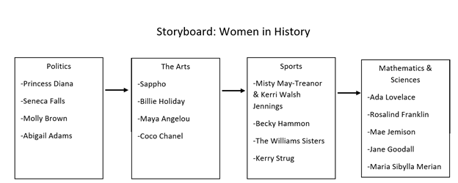
Storyboard

Slide 23
Primary Sources Graphic Organizer

Slide 24
Tracy, Jeff, Cara, Taylor, & Casey
Casey Kirsch: I am a junior at Bradley University studying Elementary Education. I hope to one day teach English as a second language to students overseas.
Jeff Pagano: I am a senior at Bradley University majoring in Elementary Education with an ESL endorsement. I hope to have my own classroom in the near future, helping make a difference in the lives of students both personally and academically.
Cara Heinemann: I am a junior at Bradley University who is working towards an Elementary Education major and Music minor. I hope to eventually work towards my gifted education certificate or my Master’s Degree in Library Science. The end goal is to bring learning to life for students of all ages.
Tracy Davis: I am a senior at Bradley University studying Elementary Education with an ESL endorsement. I hope to soon be working in my own classroom helping students to push themselves to do the best that they can in everything that they do.
Taylor Jones: I am a nontraditional student at Bradley University earning certification in Elementary Education. I teach 5th grade, and I love challenging students with hands-on activities so they gain the most out of our classroom time together.
Contact Information:
For more information, please e-mail Cara Heinemann at cmheinemann@mail.bradley.edu
A primary source is any item that provides direct or firsthand evidence about an event, object, person, or work of art. Examples of primary sources include historical and legal documents, eyewitness accounts, results of experiments, statistical data, pieces of creative writing, audio and video recordings, speeches, art objects, and more.
Return to Room
Standards
References

Slide 25
Standards
ELA Common Core Curriculum Standards
RH.6-8.1. Cite Specific textual evidence to support analysis of primary and secondary sources.
RH.6-8.2. Determine the central ideas or information of a primary or secondary source; provide an accurate summary of the source distinct from prior knowledge or opinions.
RH.6-8.9. Analyze the relationship between a primary and secondary source on the same topic.
ISBE Social Science Learning Standards
SS.H.4.6-8.LC: Explain multiple causes and effects of historical events.
SS.H.4.6-8.MC: Organize applicable evidence into a coherent argument about the past.

Slide 26
References
Abbey, E. A. Sappho. Greece, None. [Between 1870 and 1911] [Photograph] Retrieved from the Library of Congress, https://www.loc.gov/item/2010714806/.
ABC News. (2014, August 18). Becky Hammon Talks Locker Rooms, History-Making Role and Inspiration. Retrieved November 15, 2017, from
http://abcnews.go.com/Sports/becky-hammon-talks-locker-rooms-history-making-role/story?id=25016415
Biography.com Editors. (2017, November 10). Mae C. Jemison. Retrieved November 15, 2017, from https://www.biography.com/people/mae-c-jemison-9542378
Biography.com Editors. (2017, August 19). Princess Diana. Retrieved November 15, 2017, from https://www.biography.com/people/princess-diana-9273782
Clay, R. (2016, August 12). What are the Olympic Gold Medals really made from? Retrieved November 15, 2017, from
http://maxileadmetals.co.uk/what-are-the-olympic-gold-medals-really-made-from/
Fowler, D. (n.d.). Titanic Lifeboats. Retrieved November 15, 2017, from http://www.titanicfacts.net/titanic-lifeboats.html
Gottlieb, W. P. (1947) [Portrait of Billie Holiday, Downbeat, New York, N.Y., ca. Feb. 1947]. United States, 1947. ||||, Monographic. [Photograph] Retrieved from the Library of
Congress, https://www.loc.gov/item/gottlieb.04211/.
Hansen, G. (2017, June 28). 1. Kerri Strug. Retrieved November 15, 2017, from http://tucson.com/kerri-strug/article_a3cd7e06-5c47-11e7-aecc-a78ef3582dbc.html
Ignotofsky, R. (2017). Women in science: 50 fearless pioneers who changed the world. London: Wren & Rook.
The Jane Goodall Institute. (n.d.). Fun FAQs. Retrieved November 15, 2017, from http://www.janegoodall.org/our-story/faqs
Kerrin, M. T., photographer. (1995) [Rosa Parks seated left, Maya Angelou, Elaine Steele seated right and others, in Washington, D.C. for the Million Man March, 1995].
Washington D.C, 1995. [Photograph] Retrieved from the Library of Congress, https://www.loc.gov/item/2015652104/.
Massachusetts Historical Society. (2017). Adams Family Papers : An Electronic Archive. Retrieved November 15, 2017, from http://www.masshist.org/digitaladams/
The Metropolitan Museum of Art. (n.d.). Ensemble | House of Chanel, Gabrielle. Retrieved November 15, 2017, from https://www.metmuseum.org/toah/works-of-art/1984.28a-c/

Slide 27
References
National Geographic Society. (2014, March 12). Happy Birthday, Jane Goodall. Retrieved November 15, 2017, from
https://www.nationalgeographic.org/thisday/apr3/happy-birthday-jane-goodall/family/
National Museum of Women in the Arts. (n.d.). Plate 1 from Dissertation in Insect Generations and Metamorphosis in Surinam. Retrieved November 15, 2017, from
https://nmwa.org/works/plate-1-dissertation-insect-generations-and-metamorphosis-surinam
Noor. (2016, October 25). Serena and Venus - 'The Tennis Greatest'. Retrieved November 15, 2017, from
http://sportslegal.co.ke/2016/10/25/serena-and-venus-the-tennis-greatest/
Rogers, R. (n.d.). Rosalind Franklin Society - Home. Retrieved November 20, 2017, from http://www.rosalindfranklinsociety.org/
TIME. (n.d.). Women Leaders Who Are Changing the World. Retrieved November 15, 2017, from http://time.com/collection/firsts/4883293/mae-jemison-firsts/
Toole, B. (2015, October 13). Ada Lovelace Day. Retrieved November 15, 2017, from http://www.computerhistory.org/atchm/ada-lovelace-day-2/
Walsh, F. (2012, May 16). The most important photo ever taken? Retrieved November 15, 2017, from http://www.bbc.com/news/health-18041884
Wellman, J. (2012, June 20). The Seneca Falls Convention: Setting the National Stage for Women's Suffrage. Retrieved November 15, 2017, from
https://www.gilderlehrman.org/history-by-era/first-age-reform/essays/seneca-falls-convention-setting-national-stage-for-women%E2%80%99s-su

