Slide 1
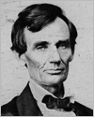
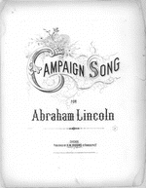
Museum Entrance
TPS Curators’ Museum
Abraham Lincoln
Artifact
22
Civil War
Emancipation
Lincoln & Douglas
Gettysburg
Curator’s
Offices
Assassination

Slide 2
Curator’s Office
Curators
Tom Bell
Social Science Educator at Limestone High School
Tami French
First Grade Educator at Valeska Hinton
Early Childhood Education Center
Candy Robosky
Special Education Educator at Washington Intermediate School
Sherrie Pardieck, David McMullen, & Dean Cantú
Teacher Education
Bradley University
Contact me at [Your linked email address]
Resources
Note: Virtual museums were first introduced by educators at Keith Valley Middle School in Horsham, Pennsylvania. This template was designed by Dr. Christy Keeler. View the Educational Virtual Museums website for more information on this instructional technique.
Return to Entry
Library of Congress American Memory (1994). [On-line]. Available www.loc.gov

Slide 3
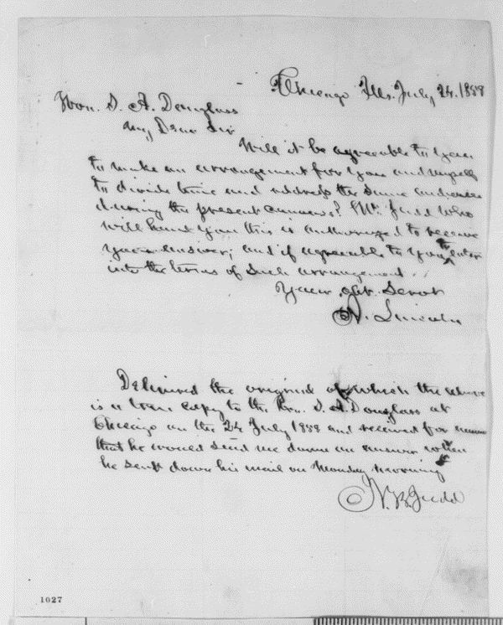
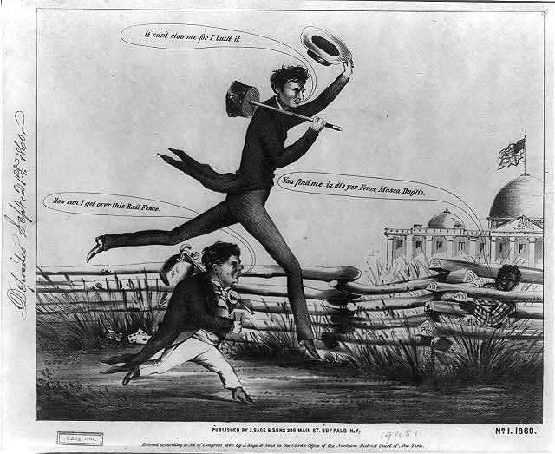
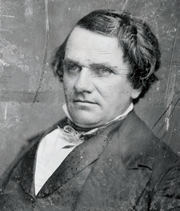
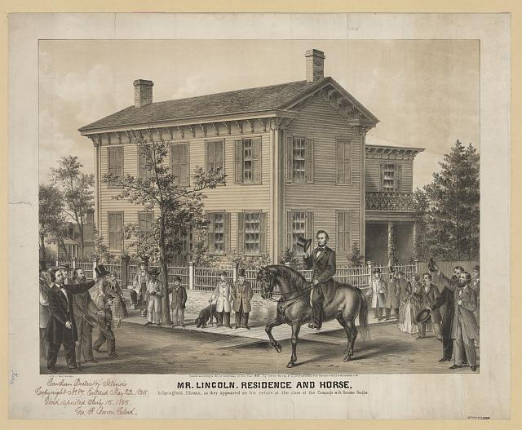
Room 1
Lincoln/Douglas Debates
Artifact
1
Artifact
2
Artifact
4
Artifact
3
Return
to
Entry

Slide 4
Abraham Lincoln and Stephan Douglas
Letter to Stephan Douglas translated:
My Dear Sir
Will it be agreeable to you to make an arrangement for you and myself to divide time and address the same audiences during the present canvass? Mr. Judd who will hand you this is authorized to receive your answer; and if agreeable to you to enter into the terms of such arrangement.
Your Obt. Servt
A. Lincoln
The Abraham Lincoln Papers at the Library of Congress Series 1. General Correspondence. 1833-1916.
Abraham Lincoln to Stephen A. Douglas, Saturday, July 24, 1858 (Debates)
http://memory.loc.gov/cgi-bin/query/P?mal:2:./temp/~ammem_CKAL
Return to Exhibit

Slide 5
Stephan Douglas
Stephen A. Douglas introduced a bill entitled the Kansas-Nebraska Act. The Act stated that new territories should have the right to decide whether or not they should have slavery.
The Senate debates were well publicized and discussed around the nation, a vote of the state legislature elected Douglas over Lincoln on November 2, 1858.
Stephen Arnold Douglas
www.loc.gov/pictures/item/2004663930/
Return to Exhibit

Slide 6
Lincoln wins the Presidency
Mr. Lincoln. Residence and horse. In Springfield, Illinois, as they appeared on his return at the close of the campaign with Senator Douglas.
Digital ID: (digital file from original print) pga- 01932
Reproduction Number: LC-DIG-pga-01932 (digital file from original print)
Repository: Library of Congress Prints and Photographs Division Washington, D.C. 20540 USA
http://hdl.loc.gov/loc.pnp/pga.01932
Return to Exhibit

Slide 7
Lincoln and Douglas
A cartoon was printed of Abraham Lincoln and Stephan Douglas as they run against each other in a foot race to the capital.
Lincoln & Douglas in a presidential footrace]. No. 1, 1860
Digital ID: (digital file from b&w film copy neg.) cph 3a17091
Reproduction Number: LC-DIG-ppmsca-15777 (digital file from original) LC-USZ62-14834 (b&w film copy neg.)
Repository: Library of Congress Prints and Photographs Division Washington, D.C. 20540 USA
http://hdl.loc.gov/loc.pnp/cph.3a17091
Return to Exhibit

Slide 8
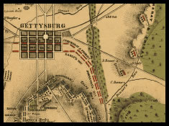
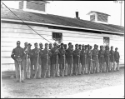
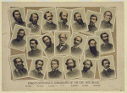
Room 2
Civil War
Artifact
5
Artifact
6
Artifact
7
Artifact
8
Return
to
Entry

Slide 9
Civil War Map
Field of Gettysburg, July 1st, 2nd & 3rd, 1863
Prepared by T. Ditterline.
CREATED/PUBLISHED [Philada. P. S. Duval & Son lith. 1863]
NOTES Scale ca. 1:25,500,.
Reference: LC Civil War Maps (2nd ed.), 331
From his Sketch of the battles of Gettysburg . . . New York,
C. A. Alvord, 1863. 24 p.
Oval-shaped map depicting troop and artillery positions, relief by hachures, drainage, roads, railroads, and houses with names of residents.
Description derived from published bibliography.
Click on map.
Return to Exhibit

Slide 10
Union Soldiers
Military installations, activities, and views, Washington, D.C., Richmond, Va., and vicinity.
Creator(s): Russell, Andrew J., photographer
Related Names: Haupt, Herman, 1817-1905, collector
Date Created/Published: ca. 1861-ca. 1865.
Medium: 146 photographic prints : albumen ; 27 x 31 cm. or smaller + text pages.
Summary: Captain Andrew. J. Russell, of the 141st New York Infantry, was the first U.S. Army photographer. He documented railroad maintenance and construction in Washington, D.C. and Virginia and military facilities in and around Washington, D.C., Maryland, and in Virginia.
Call Number: LOT 11486 (H) [P&P]
Repository: Library of Congress Prints and Photographs Division Washington, D.C. 20540 USA
Return to Exhibit
http://www.loc.gov/pictures/collection/coll/item/2004668758/

Slide 11
Confederate Army
Famous Confederate commanders of the Civil War, 1861-65
Hood Stuart, Early, Hill, Polk, J.E. Johnston, Hardee, Smith, Bragg, R. E. Lee, Beauregard, Breckinridge, A.S. Johnston, Jackson, Ewell, Hampton, Fitzhugh Lee, Price, Semmes, Longstreet.
Lithograph by Sherman Publishing Company, 1884.
www.loc.gov/pictures/item/2003674443/
Return to Exhibit
Reproduction number: LC-DIG-pga-02748

Slide 12
Company E
District of Columbia. Company E, 4th U.S. Colored Infantry, at Fort Lincoln
Creator(s): Smith, William Morris, photographer
Date Created/Published: [Between 1863 and 1866]
Medium: 1 negative : glass, wet collodion.
Summary: Photograph of Washington, 1862-1865, view of the defenses of Washington. Shows 27 African Americans in two lines with rifles resting on the ground.
www.loc.gov/pictures/item/cwp2003000946/PP/
Return to Exhibit
Call Number: LC-B817- 7890 [P&P] LOT 4190-F
References: Image of War, Vol. 3, p. 235.

Slide 13
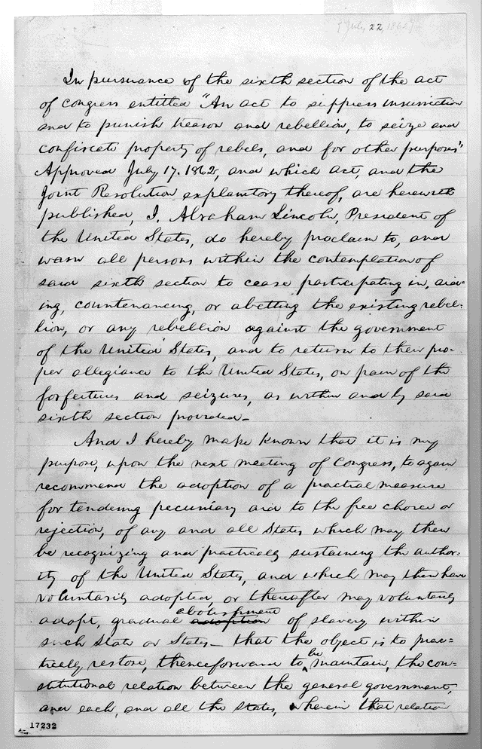
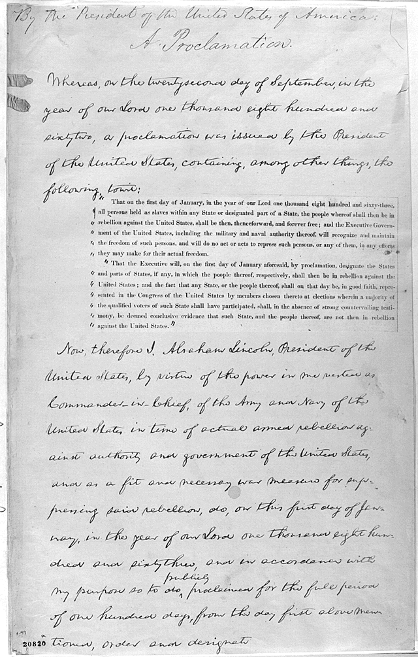
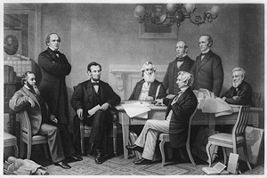
Room 3
Emancipation Proclamation
Artfact
9
Artifact
10
Artifact
12
Timeline
LLL
Return
to
Entry

Slide 14
First Draft
First page of the first draft of the Emancipation Proclamation, by President Abraham Lincoln, July 22, 1862.
The Robert Todd Lincoln Family Papers, Manuscript Division.
http://memory.loc.gov/ammem/alhtml/almss/dep001.html
Return to Exhibit

Slide 15
Emancipation Proclamation
President Lincoln met with the cabinet for the Second Confiscation Act by Congress on July 17, 1862. The document stated that slaves should be freed.
The first reading of the Emancipation Proclamation before the cabinet. Painted by F.B. Carpenter ; engraved by A.H. Ritchie, c1866. (Library of Congress, Prints and Photographs Division. Reproduction Number: LC-USZ62-2070 DLC)
http://memory.loc.gov/ammem/alhtml/almintr.html
Return to Exhibit

Slide 16
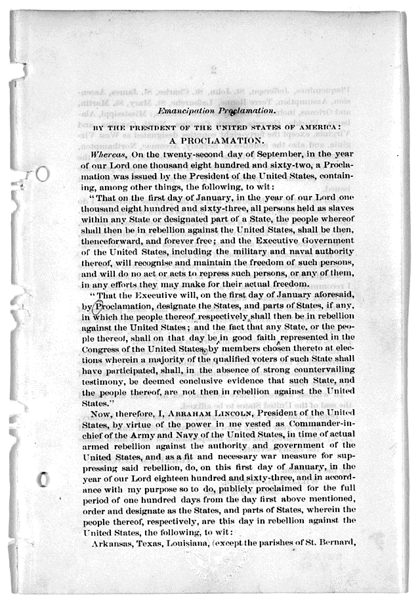
Timeline
1862
July 13 Lincoln read initial draft of the Emancipation Proclamation to Secretaries Seward and Welles.
July 22 Lincoln discussed Draft of the Emancipation Proclamation at a Cabinet Meeting.
September 22 Cabinet discussion of Emancipation. First printing of preliminary version of the Emancipation Proclamation.
1863 January 1 Lincoln signed the Final Draft of the Emancipation Proclamation.
1864 April 4 Lincoln explained his choices related to the emancipation.
http://memory.loc.gov/ammem/alhtml/almtime.html
Return to Exhibit

Slide 17
Final Draft
The Cabinet meeting of September 22, 1862, resulted in the political and literary refinement of the July draft, and on January 1, 1863, Lincoln composed the final Emancipation Proclamation. It was the crowning achievement of his administration.
The original autograph was lost in the Chicago fire of 1871. Surviving photographs of the document show it primarily in Lincoln's own hand. The superscription and ending are in the hand of a clerk, and the printed insertions are from the September draft.
Photograph copy of President Abraham Lincoln's draft of the final Emancipation Proclamation, January 1, 1863.
Original destroyed in the Chicago fire of 1871. The Robert Todd Lincoln Family Papers, Manuscript Division.
Listen to the Gettysburg Address:
http://memory.loc.gov/mbrs/berl/136012.mp3
Return to Exhibit

Slide 18
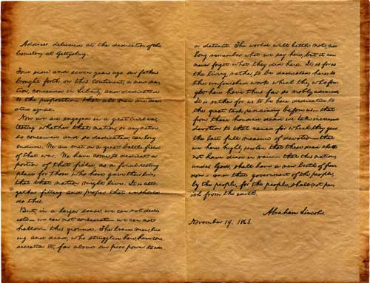
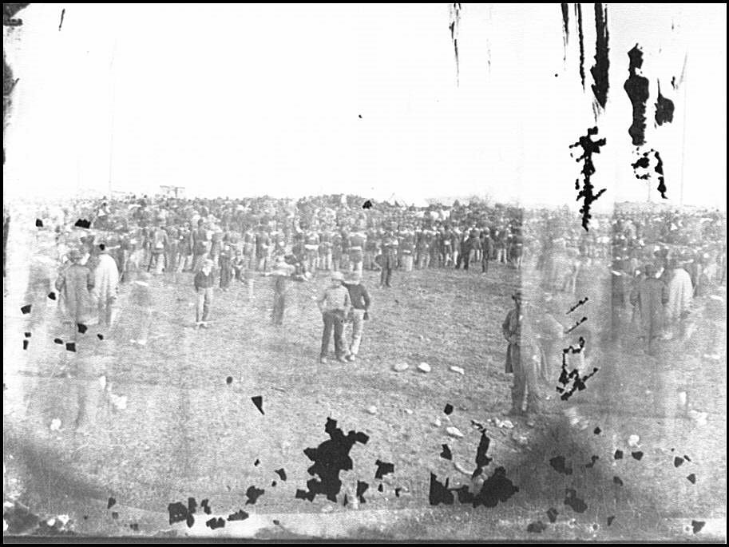
Room 4
Gettysburg
Artifact
13
Artifact
14
Fun
Facts
Artifact
15
Return
to
Entry

Slide 19
Gettysburg Address
Abraham Lincoln was the second speaker on November 19, 1863, at the dedication of the Soldiers' National Cemetery at Gettysburg. Lincoln was preceded on the podium by the famed orator Edward Everett, who spoke to the crowd for two hours. Lincoln followed with his now immortal Gettysburg Address.
On November 20, Everett wrote to Lincoln: “Permit me also to express my great admiration of the thoughts expressed by you, with such eloquent simplicity & appropriateness, at the consecration of the Cemetery. I should be glad, if I could flatter myself that I came as near to the central idea of the occasion, in two hours, as you did in two minutes.”
http://myloc.gov/Exhibitions/gettysburgaddress/Pages/default.aspx
Return to Exhibit

Slide 20
Gettysburg Address
On November 19, 1863, Abraham Lincoln delivered the Gettysburg Address in Gettysburg, Pennsylvania. Lincoln had been invited to give a "few appropriate remarks" during a ceremony to dedicate a cemetery for Union soldiers killed at the Battle of Gettysburg. Despite its brevity and the fact that it earned little attention at the time, the Gettysburg Address is considered one of Lincoln's greatest speeches.
Alfred Whital Stern (1881-1960) of Chicago presented his outstanding collection of Lincolniana to the Library of Congress in 1953. Begun by Mr. Stern in the 1920s, the collection documents the life of Abraham Lincoln (1809-1865) both through writings by and about Lincoln as well as a large body of publications concerning the issues of the times including slavery, the Civil War, Reconstruction, and related topics.
Lincoln's address at the dedication of the Gettysburg National Cemetery, November 19, 1863
Return to Exhibit
[no date recorded]. Prints & Photographs Division. Reproduction Number LC-DIG-ppmsca-19926

Slide 21
Gettysburg
CROWDS GATHER AT GETTTYSBURG, NOVEMBER 19,1863
Listen to the Gettysburg Address:
http://memory.loc.gov/mbrs/berl/136012.mp3
http://www.loc.gov/rr/program/bib/ourdocs/Gettysburg.html
Return to Exhibit

Slide 22
Fun Facts
The Edward Everett spoke for 2 hours
prior to Lincoln’s speech. Lincoln’s
speech took 2 minutes.
The speech was given on November
19, 1863, three months after the epic
battle.
Today, the Battle of Gettysburg is a
National Cemetery with both Union
and Confederate soldiers laying in
rest.
http://www.loc.gov/pictures/item/2004661438/
Return to Exhibit
Title: The battle of Gettysburg
Creator(s): Forbs, Edwin, 1839-1895, artist
Date Created/Published: 1863 July 4.
Medium: 1 drawing.
Reproduction Number: LC-DIG-ppmsca-20552 Call Number: DRWG/US - Forbes, no. 77 (A size) [P&P]
Repository: Library of Congress Prints and Photographs Division Washington, D.C. 20540 USA

Slide 23
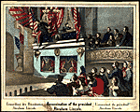
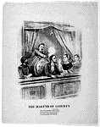
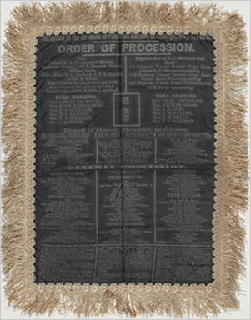
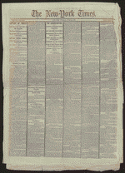
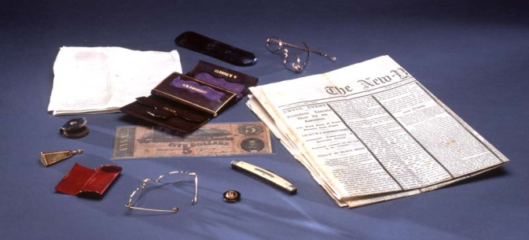
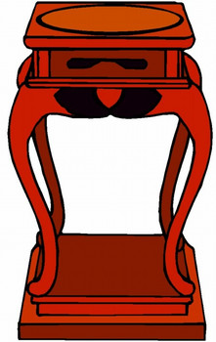
Room 5
Assassination of the President
Artifact
17
Artifact
18
Artifact
20
Artifact
19
Artifact
21
Return
to
Entry

Slide 24
Assassination of President Lincoln
Assassination of President Abraham Lincoln.
[n. p., 1865?]
Stern Collection,Rare Book and Special Collections Division.
http://memory.loc.gov/cgi-bin/query/h?ammem/scsmbib:@field(DOCID+@lit(scsm000354))
Return to Exhibit

Slide 25
Reception of Remains
President Lincoln's funeral was in Chicago on May 1, 1865. Illinoians mourned the loss of one of their own because Chicago hosted the political convention of 1860 that nominated him for the Republican ticket. The viewing of the President lasted all night and throughout the following day.
Reception of the Remains of President Lincoln. Order of Procession, May 1, 1865. Silk banner. On loan from the Union Pacific Railroad Historical Collection, Council Bluffs, Iowa (233) Digital ID # al0233
http://www.loc.gov/pictures/item/2005688778/
Return to Exhibit

Slide 26
Assassination
Title:
New York Times, [newspaper].
April 18, 1865.
Created/Published April 18, 1865 New York City, New York.
The New York Times Notes Black mourning border employed.
Return to Exhibit
http://memory.loc.gov/cgi-bin/query/h?ammem/scsmbib:@field(DOCID+@lit(scsm001307))

Slide 27
Martyr of Liberty
The Martyr of liberty...[n. p., n. d.]
Stern Collection,Rare Book and Special Collections Division.
Return to Exhibit
http://hdl.loc.gov/loc.rbc/lprbscsm.scsm0408

Slide 28
President Lincoln’s Pockets
Contents of President Lincoln’s pockets on the night he was assassinated.
Alfred Whital Stern (1881-1960) of Chicago presented his outstanding collection of Lincolniana to the Library of Congress in 1953.
Begun by Mr. Stern in the 1920s, the collection documents the life of Abraham Lincoln (1809-1865) both through writings by and about Lincoln as well as a large body of publications concerning the issues of the times including slavery, the Civil War, Reconstruction, and related topics.
http://memory.loc.gov/ammem/collections/stern-lincoln/
Return to Exhibit

Slide 29
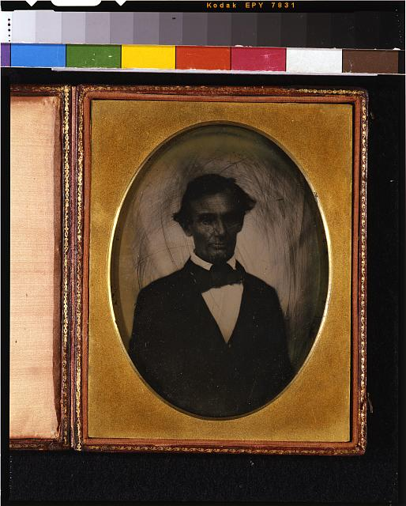
Teaching with Primary Sources
Teaching with Primary Sources (TPS) evolved out of a federally funded initiative through the Federation of Illinois Independent Colleges and Universities. The project’s objective was to aid educators’ and preservice teachers with the use of the Library of Congress digital primary sources and tools to enhance the teaching and learning process.
Primary sources are original:
documents posters
objects audio recordings
films prints and photographs
interviews music
maps journals
Library of Congress www.loc.gov
National-Louis University http://tps.nl.edu/
Bradley TPS http://hilltop.bradley.edu/~mcmullen/TPS/
Sample of a primary source:
Abraham Lincoln, head-and-shoulders portrait Pittsfield, Illinois,
two weeks before the final Lincoln-Douglas debate.
October 1, 1858 Photograph
Return to Entrance

Slide 30
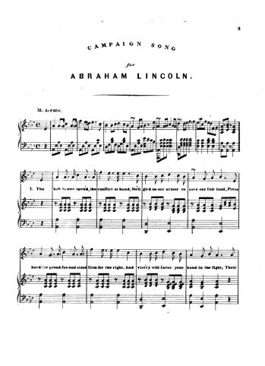
Campaign Song for Abraham Lincoln
Campaign Song for Abraham Lincoln
The ball is now open'd, the conflict at hand, We'll gird on our armor to save our fair land, Press hard the proud foe and stand firm for the right, And vict'ry will favor your band in the fight; Their chieftain must die let us strike, he will fall, He'll die from the blows of the rail splitters maul, To arms, boys! to arms and to battle we'll rush! Now charge thro' their ranks and the traitors we'll crush.
Chorus: Come all ye true hearted, let this be your cry: Our chieftain must conquer, the traitor shall die! 'Neath freedom's proud banner we'll march to the field, Now press them with vigor, the traitors shall yield.
Our banner's unfurled, let us heed the loud call, We'll march to the battle the foeman must fall, We'll join in the struggle, with hearts firm and true, We'll stand by our chief, and the red, white and blue; Then hasten brave boys, from the east and the west, We'll fight for our chief and the land we love best, We'll take up the sword for our nations bright star, Come fight 'neath our banner from near from far.
We've taken the field and their chief must be slain, We'll rally our forces our rights to maintain, Come up to the work then, the strife will be long, Our cohorts shall crush the vile traitors tho' strong; The clarion is sounding the shrill note of war, Come on, noble heroes, we'll fight for our star We never will falter, our watchword shall be The Union, the hope of the brave and the free.
Campaign song for Abraham Lincoln
Site: American Memory-cultural
Original Format: Music Score Date: 1864
The Alfred Whital Stern Collection of Lincolniana
http://memory.loc.gov/ammem/collections/stern-lincoln/catalog.html
Return to Entrance

Slide 31
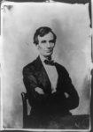
Abraham Lincoln
Title: [Abraham Lincoln, candidate for U.S. president. Half-length portrait, seated, facing front]
Creator(s): Butler Preston, photographer
Date Created/Published: [Springfield, Ill., 1860 Aug. 13, printed later, ca. 1900?]
Medium: 1 photograph : gelatin silver print
Summary: Thought to be the last beardless portrait of Lincoln, this photo was "made for the portrait painter, John Henry Brown, noted for his miniatures in ivory. ... 'There are so many hard lines in his face,' wrote Brown in his diary, 'that it becomes a mask to the inner man. His true character only shines out when in an animated conversation, or when telling an amusing tale. ... He is said to be a homely man; I do not think so.'" (Source: Ostendorf, p. 62)
Call Number: PRES FILE - Lincoln, Abraham--Portraits--Meserve no. 29 [item] [P&P]
Repository: Library of Congress Prints and Photographs Division Washington, D.C. 20540 USA http://hdl.loc.gov/loc.pnp/pp.print
Return to Exhibit

Slide 32
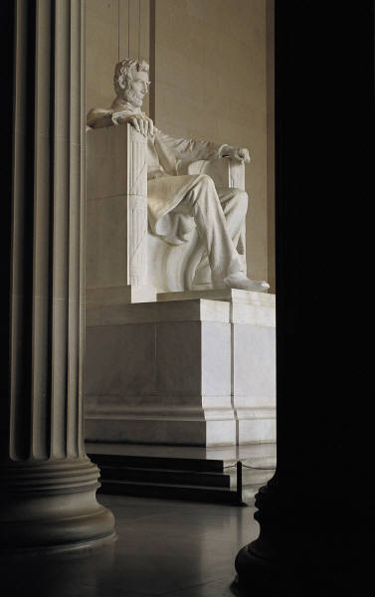
Thank you for visiting!

