Slide 1
Museum Entrance
Welcome to the Museum of
United States Presidents
Roosevelt
Washington
Truman
Kennedy
Reagan
Curator’s
Offices
Obama

Slide 2
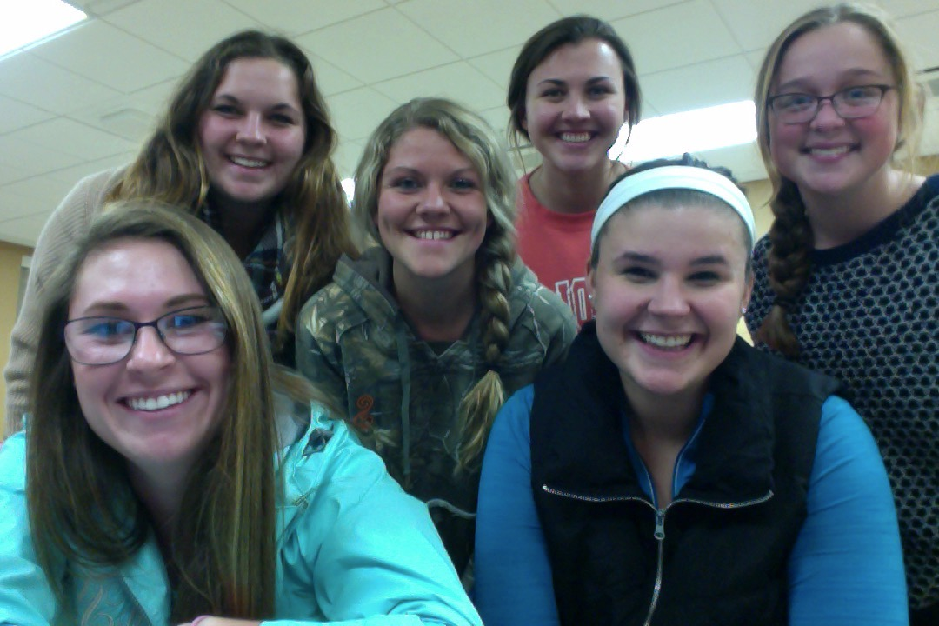
Curator’s Office
Museum Creators
Return to Entry
Ashley Taus, Cassie Neal, Jordyn Barnett, Kim Paluch, Julia Bruynseels, and Emma Campbell (from left to right).
Students of ETE 335 Social Studies Methods.
Standards
Resources
Note: Virtual museums were first introduced by educators at Keith Valley Middle School in Horsham, Pennsylvania. This template was designed by Dr. Christy Keeler. View the Educational Virtual Museums website for more information on this instructional technique.

Slide 3
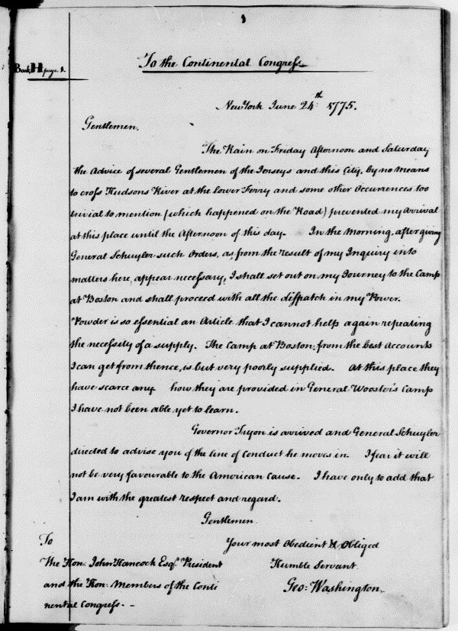
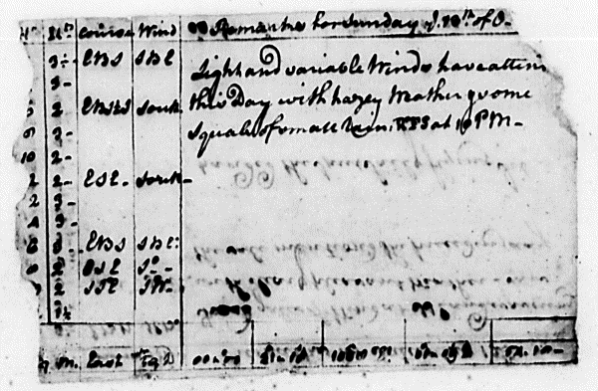
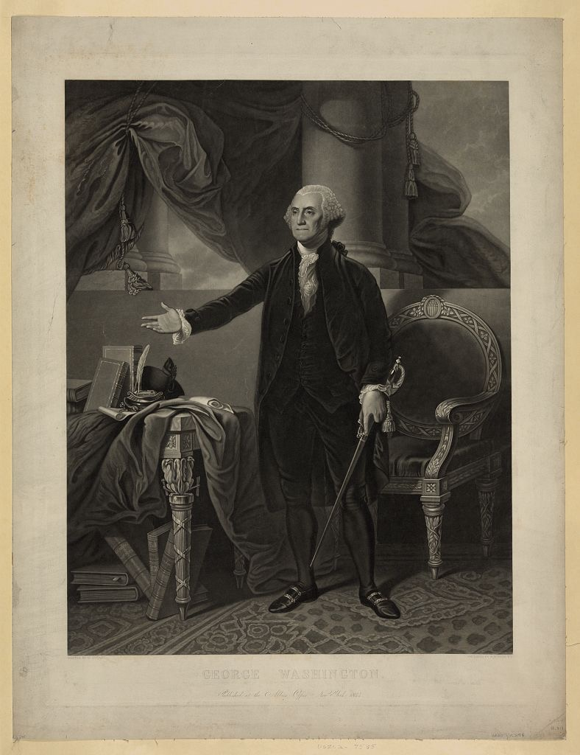
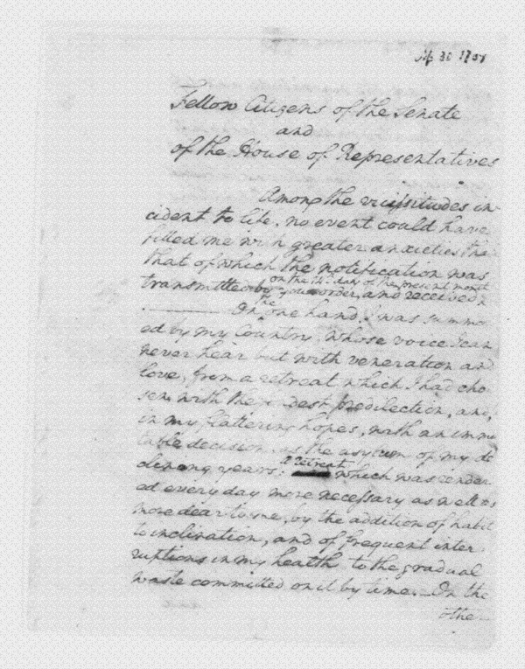
Room 1
President George Washington
Artifact
2
Artifact
1
Artifact
4
Artifact
3
Return
to
Entry

Slide 4
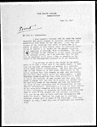
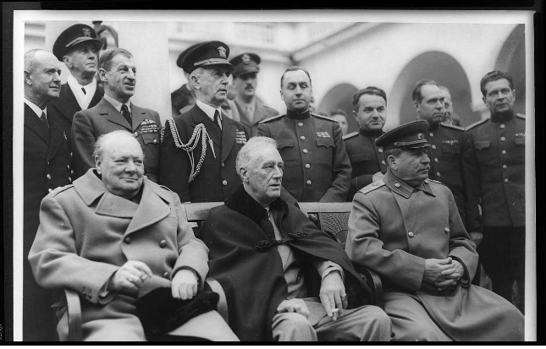
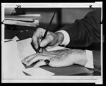
Room 2
President Franklin D. Roosevelt
Artifact
6
Artifact
5
Artifact
8
Artifact
7
Return
to
Entry

Slide 5
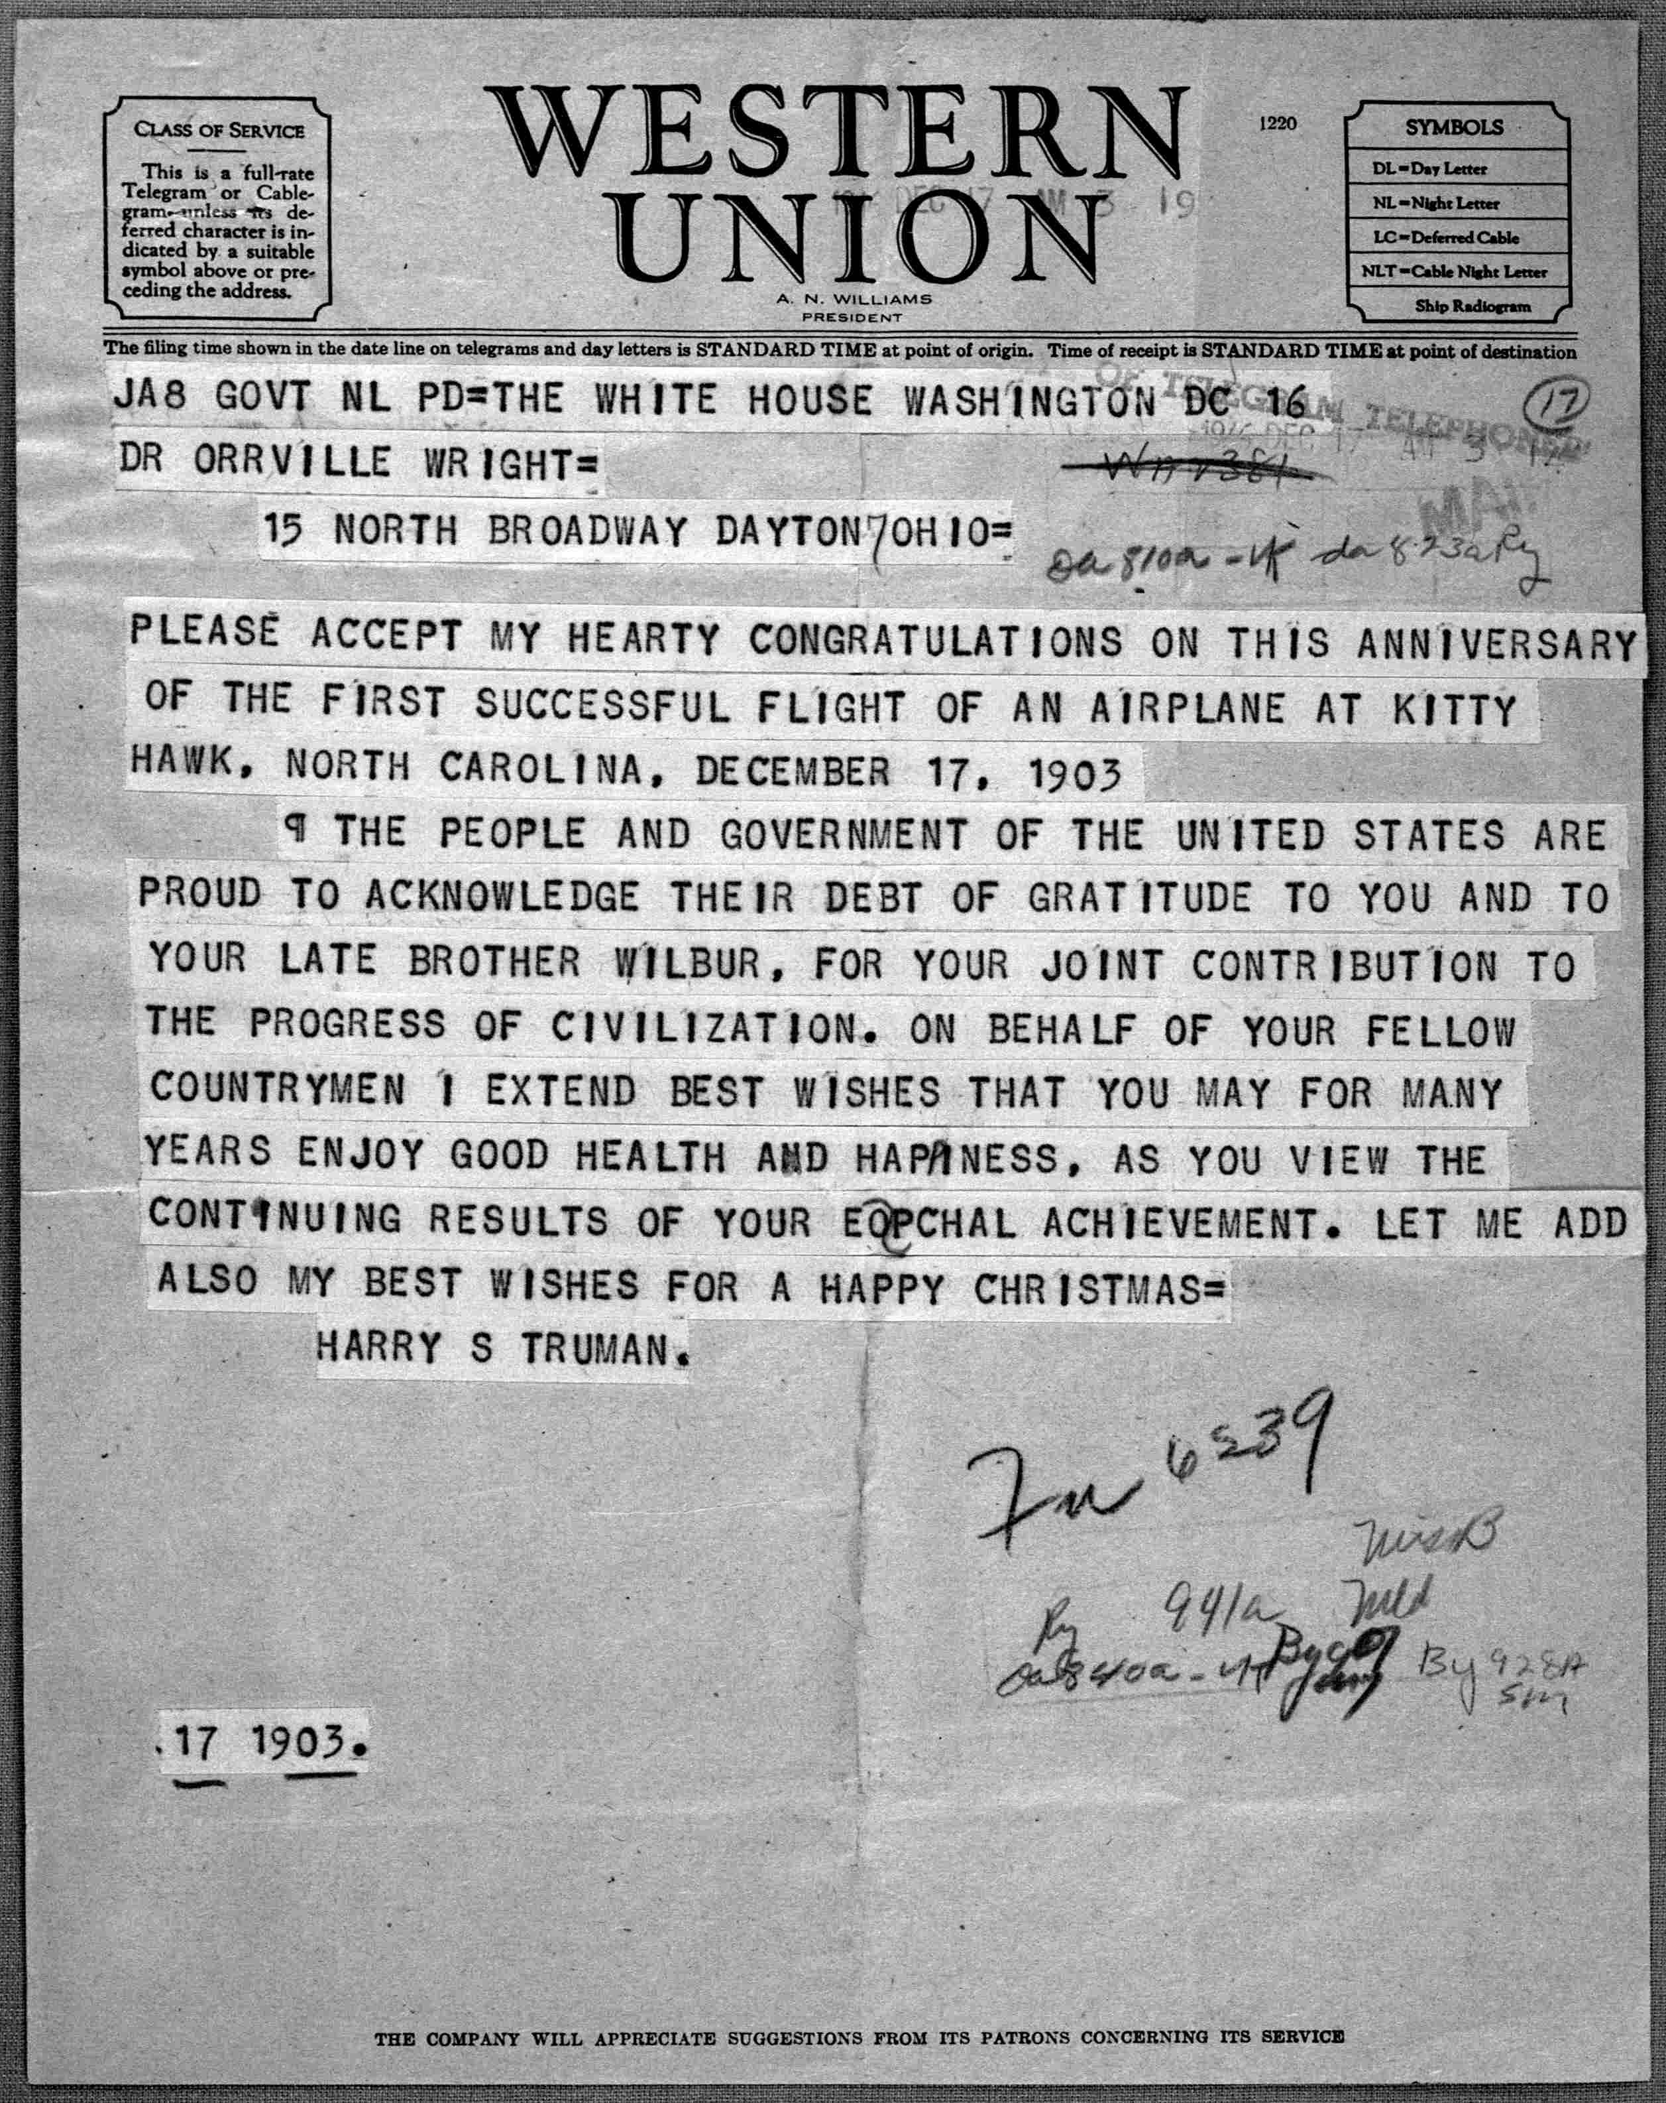
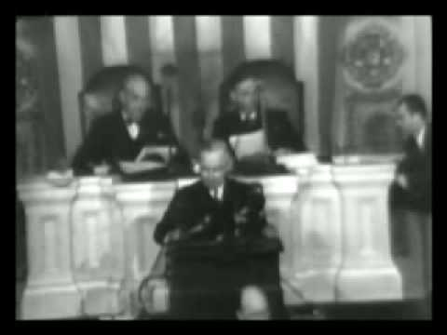
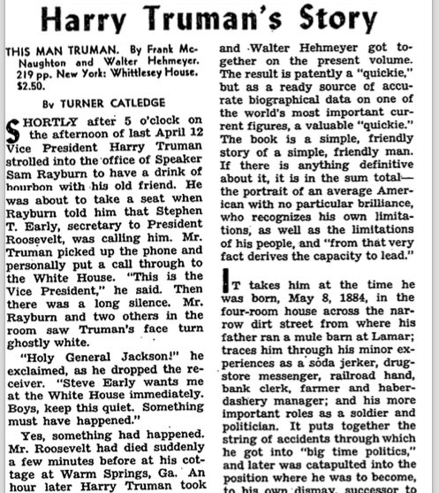
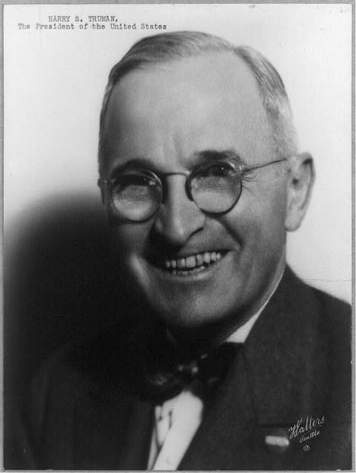
Room 3
President Harry Truman
Artifact
10
Artifact
9
Artifact
12
Artifact
11
Return
to
Entry

Slide 6
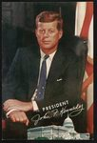
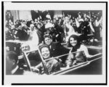
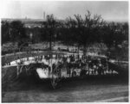
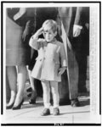
Room 4
President John F. Kennedy
Artifact
14
Artifact
13
Artifact
16
Artifact
15
Return
to
Entry

Slide 7
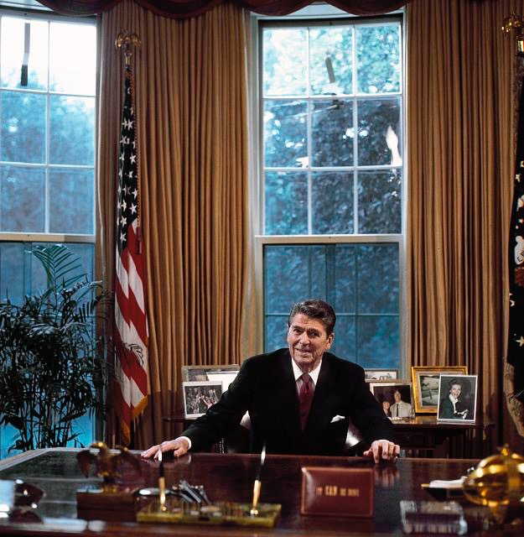
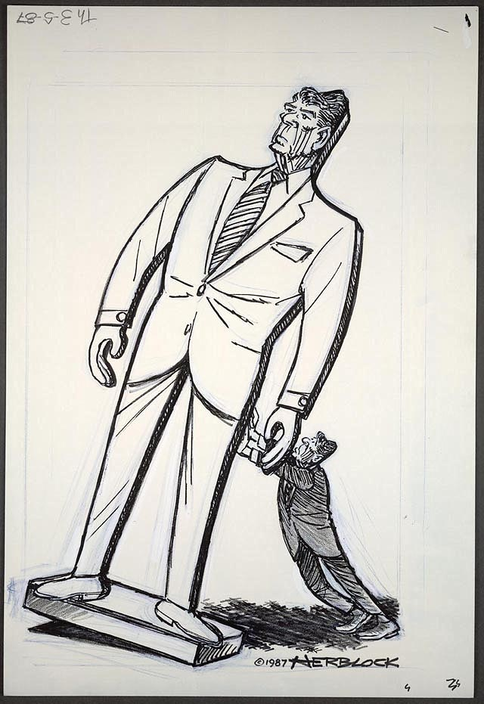
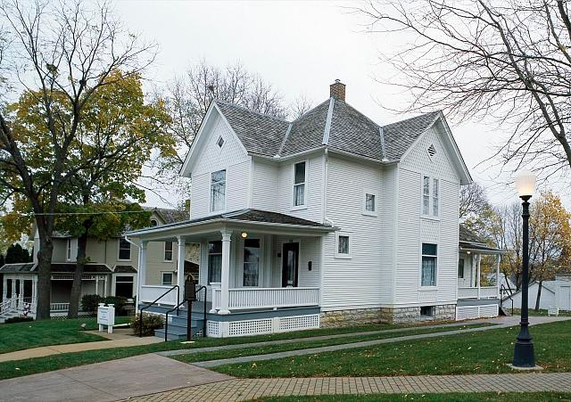
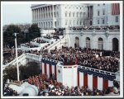
Room 4
President Ronald Reagan
Artifact
21
Artifact
19
Artifact 20
Return
to
Entry

Slide 8
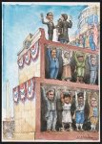
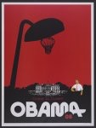
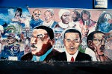
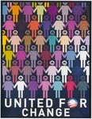
Room 5
President Barack Obama
Artifact
22
Artifact
21
Artifact
24
Artifact
23
Return
to
Entry

Slide 9
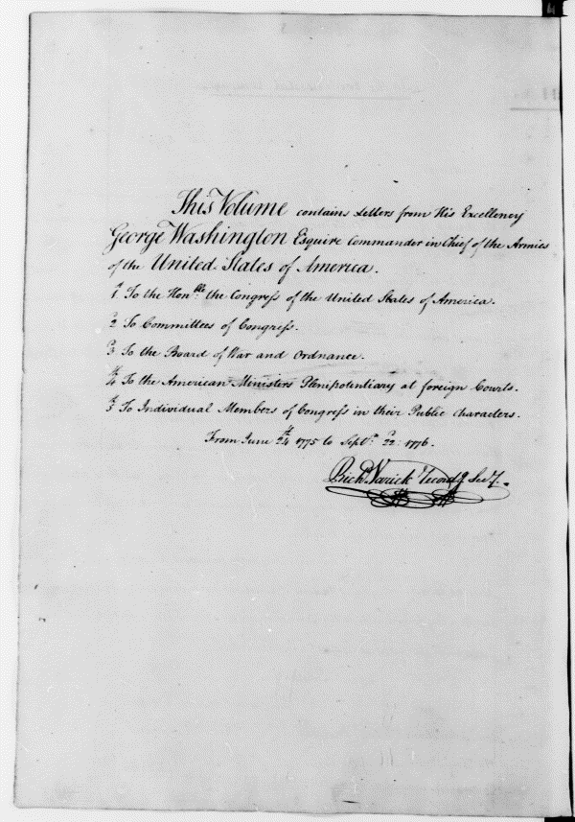
George Washington Continental Army Papers
“Varick Transcripts: Continental Army Papers. 1775-1783” They are part of the George Washington Papers, the Letterbooks, Series 3, Subseries A. These letters contain information George Washington wrote to the Continental Congress in 1775, right after America became free. Fun Fact: A double s was often spelled “fs,” so Washington actually addressed these letters “To The Continental Congress”
http://memory.loc.gov/cgi-bin/ampage?collId=mgw3&fileName=mgw3a/gwpage001.db&recNum=0
Contributor: George Washington
Date: 1775
Return to Exhibit

Slide 10
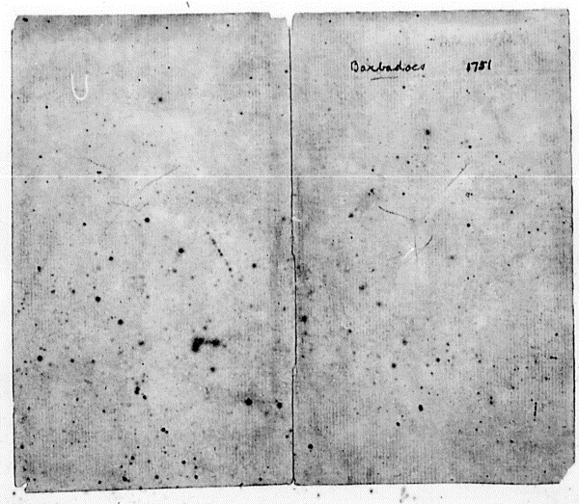
George Washington Papers
“George Washington Papers at the Library of Congress: Diary, September 28, 1751 - March 4, 1752” These are manuscripts of George Washington’s diary. There are many different manuscripts from several different years of his life, including during the war, and his presidency. Fun Fact: Some of the pages are damaged but the above picture is one of the majority that have been preserved!
http://memory.loc.gov/cgi-bin/ampage?collId=mgw1&fileName=mgw1b/gwpage511.db&recNum=0
Contributor: George Washington
Date: 1751
Return to Exhibit

Slide 11
Presidential Address Papers
George Washington, April 30, 1789, 1st Inaugural Address. This artifact is part of the collection of the George Washington papers. This was the address given by George Washington when he became president, and it was the first inaugural address ever given.
http://memory.loc.gov/cgi-bin/ampage?collId=mgw4&fileName=gwpage098.db&recNum=529
Contributor: George Washington
Date: 1789
Return to Exhibit

Slide 12
Painting of George Washington
Title: George Washington / painted by G. Stuart ; engraved by H.S. Sadd, N.Y.
George Washington, full-length portrait, standing, facing left. George Washington was the first president of the United States. He was a leader in the Continental Army prior to his presidency.
Date: 1844
Fun Fact: His hair is actually a wig, and his teeth are fake!
Return to Exhibit
Click here to learn more about George Washington: http://www.biography.com/people/george-washington-9524786#early-life-and-family

Slide 13
First Fireside Chat (March 12, 1993)
During FDR’s first days, the majority of banks had closed in response to financial crisis.
Talks with American people to soothe their fears on the state of banks.
Explained how banks worked to those who may not be familiar.
Introduces bank debilitation program and tells public what they can expect over the next few weeks-not all banks will reopen but most will resume operations.
Click Star to Watch Youtube Video.
Return to Exhibit
http://millercenter.org/president/fdroosevelt/speeches/speech-3298

Slide 14
Letter from FDR to J. Robert Oppenheimer
During World War II, the United States were developing the Manhattan Project.
The Manhattan project was a secret development project for nuclear fission
2 years before the project was successful, FDR wrote to head scientist Oppenheimer, thanking him for his work.
After FDR’s presidency, President Truman would use the completed Manhattan Project work to drop bombs on Hiroshima and Nagasaki, which quickly caused Japan to surrender.
Return to Exhibit
http://memory.loc.gov/cgibin/query/h?ammem/mcc:@field(DOCID+@lit(mcc/083))

Slide 15
“Hands Signing the New Deal”
“I pledge you, I pledge myself, to a new deal for the American people”-FDR
After his inauguration in March 1933, he set to work to fix issues with the economy.
The New Deal included bank reform laws as well as emergency, work and agricultural relief programs.
The plan was signed on June 20, 1934 and finished its work by 1939.
http://www.loc.gov/item/2005677284/
Return to Exhibit

Slide 16
“Crimean Conference--Prime Minister Winston Churchill, President Franklin D. Roosevelt, and Marshal Joseph Stalin at the palace in Yalta, where the Big Three met”
Prime Minister Churchill of the UK, President FDR, and Premier Stalin of the Soviet Union.
They discussed what Europe would look like politically post-WWII.
Main points included: Germany’s necessary surrender, the scheduling of the formation of the United Nations, return land taken during the war and free elections for Easter Europe.
Some of these agreements were kept, but others were not (Stalin installed Soviet Union-controlled governments).
Return to Exhibit
http://www.loc.gov/resource/cph.3a10098/

Slide 17
Truman Letter
In 1946, President Harry S. Truman wrote a general correspondence letter to Dr. Orrville Wright congratulating him and his brother on the anniversary of the first successful flight of an airplane on December 17, 1903. Truman and the United States government wanted to show their gratitude to the Wright brothers on their contribution to the progress of civilization.
http://www.loc.gov/item/wright002587/
Author: Harry S. Truman
Created in: 1946
Source collection: Wilbur Wright and Orville Wright papers, 1809-1979
Format: Manuscripts/Mixed Material
Return to Exhibit

Slide 18
Truman’s State of Union Address
On January 6, 1947, Harry S. Truman gave his annual State of the Union Address to the Congress. Truman’s 1947 address is famous for being the first address to be broadcast on television. The audio was recorded by Columbia Broadcasting System.
Listen to the full audio recording here: http://www.trumanlibrary.org/hstpaper/soundrecording1.htm#1947
Watch a partial video here: https://www.youtube.com/watch?v=Oc3iTGCbAcw
Recorded by: Columbia Broadcasting System
Date: Jan. 6, 1947
Return to Exhibit

Slide 19
Photo of President Truman
This picture of President Harry S. Truman was taken in 1945. He was President of the United States from April 12, 1945 to January 20, 1953. Read more about Truman’s presidency here: https://www.whitehouse.gov/1600/presidents/harrystruman
http://www.loc.gov/item/90708375/
Created: 1945
Title: Harry S. Truman, the President of the United States / Walters, Seattle
Format: Photos, Prints, Drawings
Return to Exhibit

Slide 20
Harry Truman’s Story
This is an article from the New York Times on September 16, 1945. This article, titled “Harry Truman’s Story” was written by Turner Catledge. Click on the newspaper article to read the full text.
Author: Turner Catledge
Created: Sept. 16, 1945
Publisher: New York Times
Return to Exhibit

Slide 21
Presidential Portrait of John F. Kennedy
John F. Kennedy was the 35th President of the United States (1961-1963), the youngest man elected to the office. On November 22, 1963, when he was hardly past his first thousand days in office, JFK was assassinated in Dallas, Texas, becoming also the youngest President to die.
Quote:
“… My fellow Americans, ask not what your country can do for you, ask what you can do for your country. Forgive your enemies, but never forget their names…”
www.loc.gov/item/2013646030/#about-this-item
Contributor: Bachrach, Fabian
Original Format: Photos, Prints, Drawings
Date: 1961
Return to Exhibit

Slide 22
Motorcade Parade in Dallas
November 22,1963, at 12.30pm, President Kennedy was traveling in an open top car through the streets of Dallas when three loud rifle shots rang through the air, apparently shot from the sixth floor of the nearby Book Depository building.
-the first of these bullets missed its mark, while the second penetrated the back of the President’s neck. Kennedy’s steel-boned back brace which he wore to alleviate his constant pain held Kennedy in a upright position, despite his wound – allowing the final, fatal shot to strike the back of his head.
- At 1pm local time the 35th President of the United States was pronounced dead. He was forty-six years old.
-A little over an hour after the shooting of President Kennedy, Lee Harvey Oswald was arrested on suspicion of Kennedy’s murder.
-He was not given an opportunity to defend himself against the allegations– two days later,Oswald was shot by nightclub owner, Jack Ruby, while in police custody.
www.loc.gov/item/2013646030/#about-this-item
Contributor: King, Victor Hugo
Original Format: Photos, Prints, Drawings
Date:1963
Return to Exhibit

Slide 23
JFK Jr. Saluting
John F. Kennedy Jr. saluting his father's casket outside St. Matthews Cathedral in Washington, D.C.
The day of the funeral was John Jr.'s third birthday.
http://www.loc.gov/item/95503725/
Original Format: Photos, Prints, Drawings
Date: 1963
Return to Exhibit

Slide 24
JFK Gravesite
There are only two U.S. presidents buried at Arlington National Cemetery. The other is William Howard Taft, who died in 1930
- The grave area is paved with irregular stones of Cape Cod granite, which were quarried around 1817 near the site of the president's home and selected by members of his family. Clover, and later, sedum were planted in the crevices to give the appearance of stones lying naturally in a Massachusetts field.
- Lighted by Mrs. Kennedy during the funeral, the Eternal Flame burns from the center of a five-foot circular flat-granite stone at the head of the grave
http://www.loc.gov/item/2007677195/
Original Format: Photos, Prints, Drawings
Date: 1969
Return to Exhibit

Slide 25
President Ronald Reagan’s Childhood Home
President Ronald Reagan's childhood home is located in Dixon, Illinois.
The white house at 816 Hennepin Avenue was built in 1891 by a man named William C. Thompson, who built the house for $1,500 which included the barn out back. The Reagan Family moved in on December 6th, 1920. The Reagan’s rented the home for $15 a month until 1923, where they then moved to other homes in Dixon.
http://www.loc.gov/item/2011635707/
Contributor: Highsmith, Carol M.
Original Format: Photos, Prints, Drawings
Date: 1980
Return to Exhibit

Slide 26
President Ronald Reagan in the Oval Office
President Ronald Reagan at his desk in the Oval Office, Washington, D.C.
An Oval Office Address (broadcast of a formal presidential speech from the Oval Office) President Ronald Reagan gave addressed the nation following the Space Shuttle Challenger Disaster. The Space Shuttle Challenger disaster occurred on January 28, 1986, when the NASA Space Shuttle orbiter Challenger (OV-099) (mission STS-51-L) broke apart 73 seconds into its flight, leading to the deaths of its seven crew members, which included five NASA astronauts and two Payload Specialists.
http://www.loc.gov/item/2011633940/
Contributor: Highsmith, Carol M.
Original Format: Photos, Prints, Drawings
Date: 1986
Return to Exhibit

Slide 27
Reagan Cartoon
Editorial cartoon showing a worried looking Ronald Reagan attempting to prevent a larger-than-life sized figure of himself from toppling.
http://www.loc.gov/item/00652265/
Contributor: Block, Herbert
Original Format:Photos, Prints, Drawings
Date: 1987
Return to Exhibit

Slide 28
President Ronald Reagan Delivering his Inaugural Address
President Ronald Reagan delivering his inaugural address on the west front of the U.S. Capitol, January 20, 1981.
The first inauguration of Ronald Reagan as the 40th President of the United States (January 20, 1981). The inauguration marked his first four-year term as President and George H. W. Bush as Vice President.
http://www.loc.gov/item/00652323/
Original Format: Photos, Prints, Drawings
Date: 1981
Return to Exhibit

Slide 29
African American Leader Photo
This is a photograph that shows many African American leaders in a mural that features King, Malcolm X, and Obama. Also shown are Stevie Wonder, Harriet Tubman, Marcus Garvey, a fighter pilot, Egyptian pharaohs, and others. These African American leaders have made a big impact on historical events.
https://www.loc.gov/item/2015647516/
Contributor: Vergara, Camilo J.
Original Format: Photos, Prints, Drawings
Date: 2010
Return to Exhibit

Slide 30
President Obama - Political Poster
This is a political poster that shows Barack Obama holding a basketball and looking at the hoop with the White House in the background.
https://www.loc.gov/item/2010648385/
Contributor: Noland, Ray
Original Format: Photos, Prints, Drawings
Date: 2008
Return to Exhibit

Slide 31
Obama Presidential Election Campaign Poster
This is a political poster for Barack Obama 2008 presidential election campaign showing faceless people of various colors holding hands.
https://www.loc.gov/item/2012646808/
Original Format: Photos, Prints, Drawings
Date: 2008
Return to Exhibit

Slide 32
Obama Cartoon
This is an editorial cartoon drawing that shows Barack Obama taking the oath of office as the 44th President of the United States; shown in a cut-away portion of the platform are historical figures, Abraham Lincoln, Benjamin Franklin, Martin Luther King, Jr. among them, standing with their arms raised, supporting the structural level above them.
https://www.loc.gov/item/2011647560/
Contributor: Wuerker, Matt
Original Format: Photos, Prints, Drawings
Date: 2009
Return to Exhibit

Slide 33
Standards
NCSS.2.1.d
assist the learners in developing historical research capabilities that enable them to formulate historical questions, obtain historical data, question historical data, identify the gaps in available records, place records in context, and construct sound historical interpretations;
CCSS.ELA-Literacy.RH.6-8.2 Determine the central ideas or information of a primary or secondary source; provide an accurate summary of the source distinct from prior knowledge or opinions. CCSS.ELA-Literacy.RH.6-8.7 Integrate visual information (e.g., in charts, graphs, photographs, videos, or maps) with other information in print and digital texts
Return to Exhibit

Slide 34
Resources
http://www.historyinanhour.com/2012/11/22/assassination-of-john-f-kennedy-summary
https://www.loc.gov/
http://www.history.com/topics/world-war-ii/yalta-conference
http://www.loc.gov/teachers/classroommaterials/presentationsandactivities/presentations/timeline/depwwii/newdeal/
http://memory.loc.gov/cgibin/query/h?ammem/mcc:@field(DOCID+@lit(mcc/083))
http://millercenter.org/president/fdroosevelt/speeches/speech-3298
Return to Exhibit

