Slide 1
Teaching with Primary Sources Using Visual Literacy Skills
Sherrie Pardieck
David McMullen
Dean Cantú
Bradley University

Slide 2
Teaching with Primary Sources
Federally funded project of Library of Congress to highlight resources of Library of Congress Website
Designed to prepare teachers to access, use, and produce curriculum using the digitized primary source materials from the Library of Congress
Four Illinois Universities
Teacher Cohort

Slide 3
Primary Sources
Original artifacts and documents of
people
places
events
Every human being creates primary
sources throughout their lifetime. Primary
sources are records of our existence!

Slide 4
Library of Congress Primary Sources
Panoramic views of locations
Movies
Interviews
Music
Sheet music
Diaries
Books
Magnification of maps
Multiple views and enlargement of artifacts
Trivia questions
Word games
Posters
. . .and more!

Slide 5
Visual Literacy
Interpreting, decoding, and reading information and symbols.
Visual Vocabulary-arrangement of lines, focal points, shapes, texture, light, color, and movement.
Visual Thinking-readers interpret images and translate into understandable information organized with graphics.
Using Critical Thinking Skills-analyzing details, making comparisons, and connecting prior knowledge.
Critical Viewing-readers identify pieces to support statements or predictions.

Slide 6
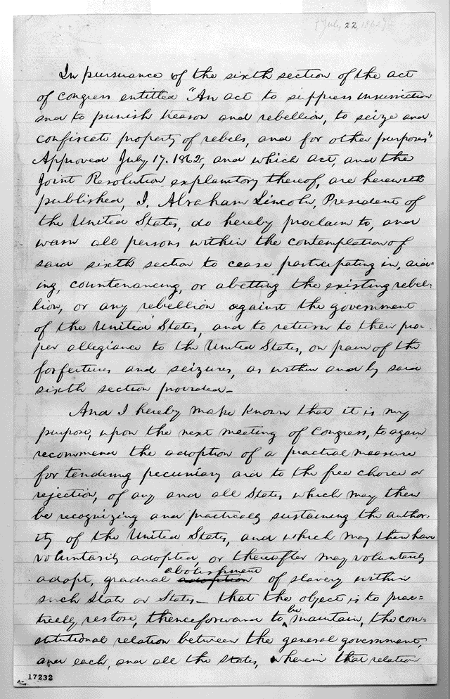

Slide 7
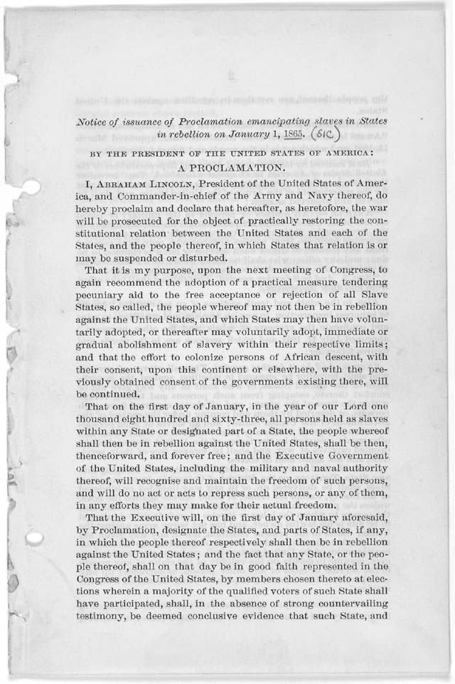
First Draft of the Emancipation Proclamation. Abraham Lincoln. July 22, 1862. The Robert Todd Lincoln Family Papers, Manuscript Division.
Photograph copy of President Abraham
Lincoln's draft of the final Emancipation Proclamation. January 1, 1863. The Robert Todd Lincoln Family Papers, Manuscript Division.

Slide 8
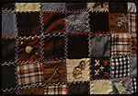
What is it?

Slide 9
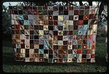
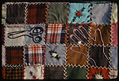

Slide 10
Crazy Quilt
By Zenna Todd (1978)
I usually took, uh, take an old bed linen sheet, and tear it in squares, and then just sew this, sew this material on that, and that give it a little extra hold. It'd last, you know, better. And that was what we called the crazy quilt. And we'd find different ways to put 'em together. We'd start at one corner and sew on a little strip and then go, you know, and then we'd have so many blocks and sew them together and we'd have one turned one way and one the other, and that way it give it a kinda little different design. And then sometimes we would take, after we, we'd tear the blocks about six-by-six or eight-by-eight, square, and we'd take four and put 'em together and put a little two-inch strip or inch-and-a-half, in between the four, you know, and then put 'em together with a bigger piece, about two inches or something. And that made 'em real pretty in a way. And then it, you know, it was something to keep you warm.
http://memory.loc.gov/cgi-bin/query/p?ammem/qlt:@FIELD(DOCID+@RANGE(br001+le181))::SortBy=DOCID

Slide 11
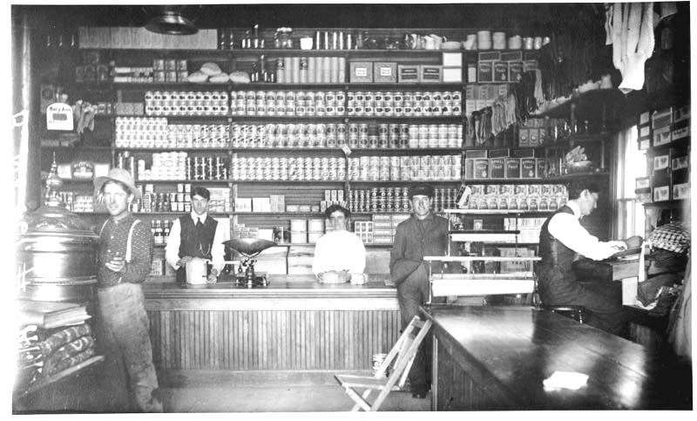

Slide 12
A Fine example of a general store in pioneer days.
CREATED/PUBLISHED [190-?]
SUMMARY Interior of general store with men and a woman behind the counter. Other men in front of counter and by stove. Behind counter is shelving going to ceiling, full of goods. People not identified, likely in North Dakota.
NOTES Title taken from label with print.
"Fred Hultstrand copy of glass plate from Howard Berg collection, Devils Lake, N.D. Copied July 28, 1965"--Back of b&w print.
Original photographer likely Job V. Harrison of Rock Lake, N.D.
Cite as: Fred Hultstrand History in Pictures Collection, NDIRS-NDSU, Fargo.
Gift; Verwest, Donna Jean 1969.

Slide 13
Visual Literacy Questions
Analysis Skills:
What do you see?
What is happing?
What items are being displayed?
Describe items.
Why are they included in the visual image?
What cultural differences do you see in the image?
What is the time period of the image?
Comparison of two or more primary sources,
identification of similarities and differences.

Slide 14
Visual Literacy
Critical thinking skills:
Does the visual tell a story?
What is the significance of the visual?
Is this an important artifact? Why?
Summarize what you see.

Slide 15
Visual Literacy
Research skills:
Look up the history of the artifact (follow LOC links).
Compare predictions to the factual information.
Application:
A final product may include a project, discussion, role playing, research paper, graphic organizer, illustrations, etc. The final product would be used for assessment purposes.

Slide 16
Visual Literacy
Using visual literacy and the LOC primary sources for the teaching and learning process provides students’ with opportunities to interpret, decode, and read visual information and symbols. Students use visual vocabulary, visual thinking, critical thinking, critical viewing, and research skills as they connect meaning to authentic materials.

Slide 17
References
Avgerinou, M. D. (2009). Re-viewing visual literacy in the “baind’ images” era.
TechTrends, 53 (2), 28-34.
Danzer, G. A., & Newman, M. (1991). Tuning in: Primary sources in the teaching of
history. Chicago, IL: The World History Project, University of Illinois at Chicago1991.
Gardner, H. (2000). Intelligence reframed: Multiple intelligences in the 21st century.
New York, NY: Basic Books.
Library of Congress (2006). [On-line]. Available www.loc.gov
Pardieck, S. (2008). Creating personal connections: Exploring the immigration to
Chinatown in Chicago, Illinois. Journal of the Illinois Council for the Social Studies, (68), 1-6.
Petri, G. G. (2003). The American memory collection from a-a: Primary resource guide
and reproducible activities across the curriculum grades 7-9. Worthington, OH: Linworth Publishing, Inc.
Teale, W. H. (2009). Students learning English and their literacy instruction in urban
schools. Reading Teacher, 62 (8), 699-703.
Veccia, S. H. (2004). Uncovering our history: Teaching with primary sources. Chicago, IL: American Library Association.
Zambo, D. M. (2009). Using visual literacy to help adolescents understand how images influence their lives. Teaching Exceptional Children, 41 (6), 60-67.
Zemelman, S., Daniels, H., & Hyde, A. (1998). Best practice: New standards for
teaching and learning in America’s schools. Portsmouth, NH: Heinemann.

Slide 18
Contact:
Sherrie Pardieck sherrie@fsmail.bradley.edu
David McMullen mcmullen@fsmail.bradley.edu
Dean Cantú dcantu@fsmail.bradley.edu
Websites:
Library of Congress www.loc.gov
Federation of Illinois Independent Colleges and
Universities http://www.tpsfed.org/
Bradley University http://bradleytps.weebly.com/

