Slide 1
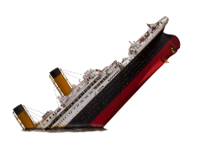
Museum Entrance
The Titanic Museum
Meet the Curators
Building of the Titanic
Life on the Ship
Important People on the Ship
Sinking
Welcome to the Lobby

Slide 2
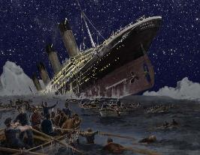
Curator Information
The Titanic Museum
Standards
Andrea Ferguson
Elementary Education Major with an ESL Endorsement
amferguson@mail.bradley.edu
Devyn Slick
Elementary Education Major with an ESL Endorsement
dslick@mail.bradley.edu
Ashley Jones
Elementary Education Major with an ESL Endorsement
ajjones@mail.bradley.edu
Cassandra Whiteside
Special Education Major with an ESL Endorsement
cpwhiteside@mail.bradley.edu
SS.IS.3.6-8. Determine sources representing multiple points of view that will assist in organizing a research plan.
SS.IS.5.6-8.MdC. Identify evidence from multiple sources to support claims, noting its limitations
SS.H.4.6-8.LC. Explain multiple causes and effects of historical events.
Back to Lobby
Resources
Note: Virtual museums were first introduced by educators at Keith Valley Middle School in Horsham, Pennsylvania. This template was designed by Lindsey Warneka under the direction of Dr. Christy Keeler during a Teaching American History grant module. View the Educational Virtual Museums website for more information on this instructional technique.

Slide 3
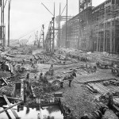
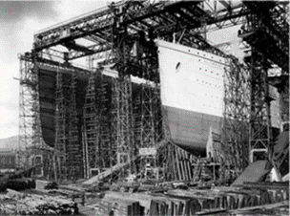
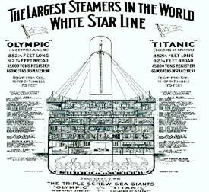
Building the Titanic
The Titanic Museum
Back to Lobby
Notes:
Building the titanic

Slide 4
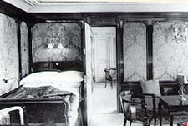
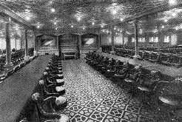
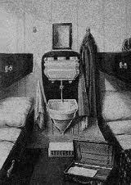
Life on the Titanic
The Titanic Museum
Back to Lobby
Notes:
Life on the ship
4

Slide 5
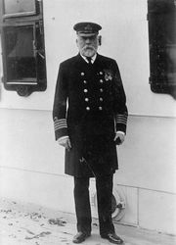
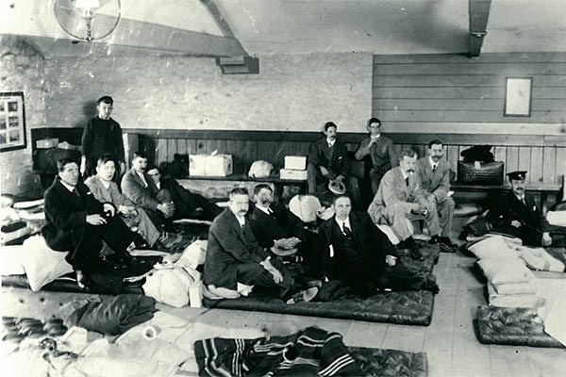
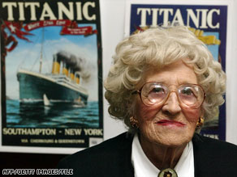
Important People
The Titanic Museum
\
Back to Lobby
Notes:
Important people
5

Slide 6
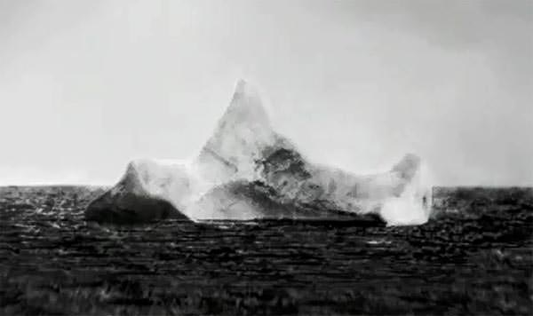
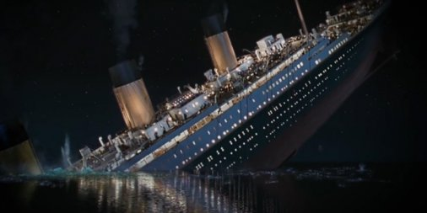
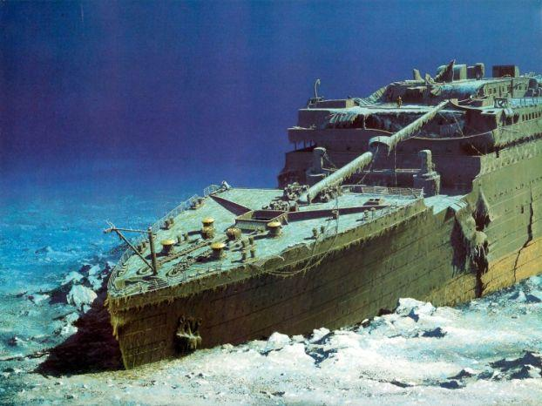
Sinking of the Titanic
The Titanic Museum
Back to Lobby
Notes:
sinking
6

Slide 7
Construction
In 1907, the White Star Line's rival, Cunard, launched the two fastest passenger ships in service at the time. This sparked competition which began the design and construction of the Titanic. Unlike Cunard’s ship, they didn’t focus on improving speed but rather focused on the size and luxury of the ship. The Titanic was built by Harland & Wollf, White Star Line’s longtime shipbuilder. Construction started on the ship in Belfast, northern Ireland in late 1908. Of Harland & Wolff's 15,000 workers, around 3,000 worked on the Titanic.
Back to Room 1
Notes:
Artifact 2

Slide 8
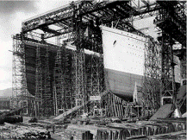
Description
Insert Artifact
Picture Here
The Titanic was nearly 883 feet long and 104 feet high. It was claimed to be “unsinkable” based on its design of sixteen compartments separated by bulkheads in the lower portion of the ship. There were doors between each of the compartments that were supposed to be easy to close with the flip of a switch in case of an emergency, sealing the compartments off from one another and theoretically keeping water confined to the separate compartments. Unfortunately, this system failed when water reached five of the compartments and managed to sink the Titanic.
Back to Room 1
Notes:
Artifact 3

Slide 9
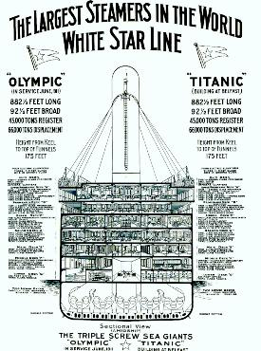
Back to Room 1

Slide 10
First Class Travel
The first class passengers on the Titanic were prominent members of the upper-class. The travelers in first class mainly consisted of politicians, businessmen, bankers, professional athletes, industrialists and high-ranking military personnel. A first class ticket ranged from thirty to 870 pounds, today that would be an about $70,000 per first class ticket. The first class passengers could enjoy a lot more amenities than the other classes. Some of those amenities included, tea gardens, heated swimming pool, gymnasium, reading and writing rooms, and a library. On the night the Titanic sank, the first class passengers enjoyed a 10-course meal. The menu included oysters, filet mignon, poached salmon, chicken Lyonnaise, foie gras, roasted pigeon, lamb with mint sauce and Punch Romaine, which was ice that was flavored with oranges and drenched in champagne. The first class had 39 private suites on the Titanic which included bedrooms with private toilet facilities.
Back to Room 2

Slide 11
Second Class Travel
The second class passengers on the Titanic would be comparable to the middle class we have today. The travelers in second class mainly consisted of professors, authors, clergymen, and tourists. A second class ticket cost about 13 to 79 pounds which is about $1800 today. In second class, the passengers had a few more rooms to enjoy than the third class did. Which includes a library and a smoke room. The meal consisted of three courses, the first course would consist of soup, the second course was the main meal, and then the third course would include desserts followed by coffee. In the second class cabin, privacy was hard to come. The second class cabin included a washbasin and a chamber pot in case of seasickness. The passengers also had to use communal bathrooms.
Back to Room 2

Slide 12
Third Class Travel
The third class passengers on board the Titanic were primarily immigrants that were moving to the United States. The price of a third class ticket ranged from seven to forty pounds which is about $700 today. They lived a simple life on the Titanic compared to the first and second class passengers. They only had a few rooms that they had access to on the ship so they had to make their own fun. Third class only had one course that was served to them. On the night the Titanic sank, the third class passengers were served soup, roasted pork, two or three vegetables, pudding and biscuits which was a smaller meal compared to what the other classes were served. Their rooms were located in the steerage of the ship in which the passengers slept on bunk beds in crowded quarters at six to a narrow cabin.
Back to Room 2

Slide 13
Captain Edward J. Smith
The Titanic wasn’t the first ship Captain Edward J. Smith commanded. In fact, it was his the sixth ship he commanded. Captain Smith joined the White Star Line in 1880, over 30 years before taking command of The Titanic. When the warning about dangerous ice came about, Smith posted the message but went on with his day, leading a religious service for the first class passengers. After three more warnings came, the Captain to brush them aside and turn in for the night. Unfortunately, this lack of care caused the ship to brush against an iceberg causing The Titanic to sink. Captain Smith died with the Titanic on April 15th.
Back to Room 3

Slide 14
Survivors
Out of the 2,228 passengers and crew on The Titanic, only 31.6% survived the sinking. Within the three classes, 61% of the First Class passengers survived, 42% of the Second Class Passengers survived, and only 24% of the Third Class passengers survived. In regards to gender, 75% of female passengers survived while only 20% of male passengers survived. The survivors were lost at sea for nine days without being found.
Back to Room 3

Slide 15
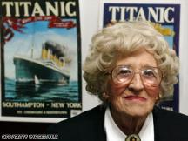
Millvina Dean
Insert Artifact
Picture Here
Millvina Dean was the last known survivor of The Titanic. Dean was just 9 weeks old when she sailed on The Titanic with her parents. Millvina sailed in third class with her parents and was one of the 24% of people that survived that had sailed in third class. She was also just one of 56 children that survived the sinking of the ship. Dean died on May 31st, 2009 at age 97. On April 15, 2002, she and three other living survivors, unveiled a plaque in Southampton to mark the 90th anniversary of the sinking of The Titanic.
Back to Room 3

Slide 16
Titanic Iceberg
What to Know about the Crash
On April 14th, 1912 at 11:40 pm, the Titanic hit an iceberg while traveling through the icy waters of the Atlantic Ocean. The Titanic was moving at a speed of 22.5 knots when she hit the iceberg, just half a knot slower than her top speed of 23 knots. The crew members of the ship saw the iceberg and warned the captain only 30 seconds before the ship collided with it. The length of the gash the iceberg made on the ship was approximately 245 feet long. Every second, approximately 1,400 liters of water rushed into the ship, causing it to sink within 2 and a half hours. 1500 lives were lost that night.
Back to Room 4

Slide 17
CGI Sinking of Titanic
In 2012, a video was put together by James Cameron, the director of the movie Titanic. Cameron and his team work together to make a computer generated image (CGI) film that demonstrates the entire collision: from the ship hitting the iceberg, to the ship splitting in half, to the sinking of the Titanic.
Once the ship hit the iceberg, it tried to steer the back of the ship away, to avoid collision with the entire ship. As the structure started to be pulled underneath the water, the stern rose above the water. The amount of stress on the area of the ship at the waterline is what caused the ship to split in half, causing the ship to sink in 2 separate parts. The parts of the ship sank at speeds of up to 50 mph, causing pieces of the structure to be ripped off in the water. The two portions eventually reach the bottom of the ocean, sinking a distance of 2.4 miles.
Back to Room 4

Slide 18
A Century Later
This photo was captured in 2010. After the Titanic sank in 1912, its whereabouts remained a mystery for over 70 years until it was found by Dr. Robert Ballard in 1985. For 7 decades, it was unknown what happened to the remnants of the Titanic, or where it even was. People wondered how the largest ship in the world had completely disappeared. When found, the two pieces lay 400 meters apart from each other. China plates, pieces of furniture, and parts of the ship lay among the wreckage.
Back to Room 4

Slide 19
Resources
The Titanic Museum
Fowler, D. (n.d.). How Did The Titanic Sink? Retrieved April 13, 2017, from http://www.titanicfacts.net/how-did-the-titanic-sink.html
Fowler, D. (n.d.). Titanic Survivors. Retrieved April 06, 2017, from http://www.titanicfacts.net/titanic-survivors.html
Godoy, M. (2012, April 13). Dining With Disaster: Reviving The Last Meal On The Titanic. Retrieved April 09, 2017, from http://www.npr.org/sections /thesalt/2012/04/13/150508849/dining-with-disaster-revivingthe-last- meal-on-the-titanic/
Matthews, D. L. (2012, April 10). First Class Life on the Titanic. Retrieved April 09, 2017, from https://alookthrutime.wordpress.com/2012/04/10/first-class-life-on-the-titanic/
Inside Titanic. (n.d.). Retrieved April 09, 2017, from http://www.ultimatetitanic.com/interior-fittings/#.WOWlHIWcFGw
Titanic Construction. (n.d.). Retrieved April 13, 2017, from http://www.titanicuniverse.com/titanic-construction
Titanic Wiki. (n.d.). Edward John Smith. Retrieved April 06, 2017, from http://titanic.wikia.com/wiki/Edward_John_Smith

